Slide 1
The Canon of Scripture
Church History-14

Slide 2
The Canon
What does “canon” mean?
It comes from a Greek word that means “measuring rod”
The canon of Scripture are those written documents that measure up to the qualifications of Scripture—it is the list of books that Christians believe to be inspired and authoritative

Slide 3
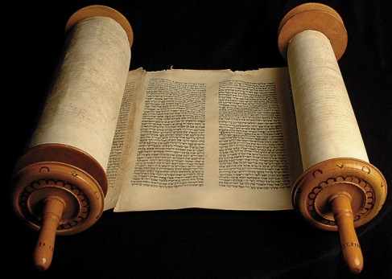
Need for a canon
Many documents about Jesus and the Christian faith were written in the time of the early church; as the generations got farther and farther from the first century, they used these documents as their main source of information about true Christianity
Heresies that began to circulate made it necessary to identify which writings were really authoritative and which ones were not

Slide 4
The Formation of the Canon
Christians accepted the Jewish Scripture as God’s Word, calling it the Old Testament.
Tests for the authenticity of New Testament writings:
Was it written by an apostle or someone close to an apostle?
Is it widely used in Christian worship?
Does it have power?

Slide 5
The Formation of the Canon
Many books, such as the Gnostic Gospel of Thomas, were never seriously considered for inclusion in the canon.
Most New Testament books were accepted practically from the start.
The four gospels
Acts
Paul’s epistles
1 John
Revelation

Slide 6
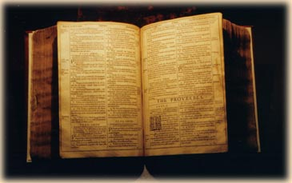
The Formation of the Canon
Other books were more controversial.
Some were eventually accepted.
Hebrews
James
1 and 2 Peter
2 and 3 John
Jude
Others were not
The Shepherd of Hermas
Letter of Barnabas
Revelation of Peter
The canon as we have it was fixed by about 400.

