Slide 1
Establishment of Roman Catholic church throughout Europe
18-Church History

Slide 2
Spread of Christianity
Notes:
Insert map of the spread of Christianity over the first millenium

Slide 3
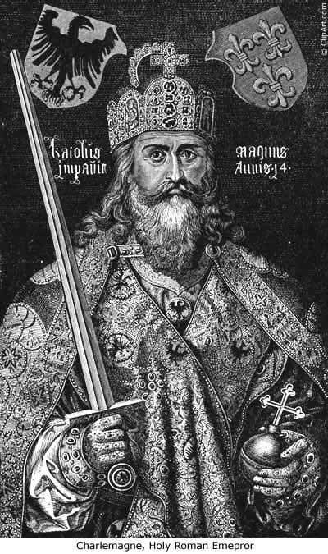
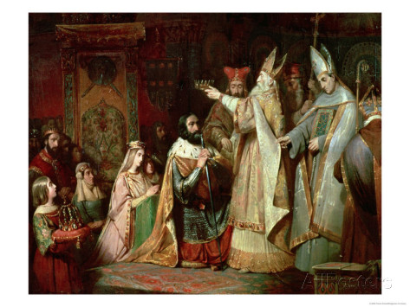
Charlemagne

Slide 4
Holy roman Empire
Notes:
Insert maps of Holy Roman Empire.

Slide 5
