Slide 1
Preparation for the Messiah
Church History-Mr. Myers

Slide 2
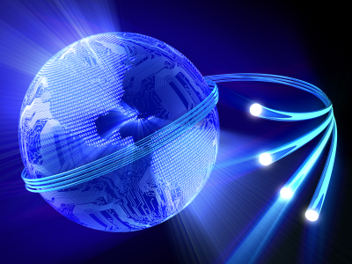
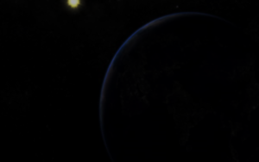
World Full of Life and Light/ World Unplugged

Slide 3
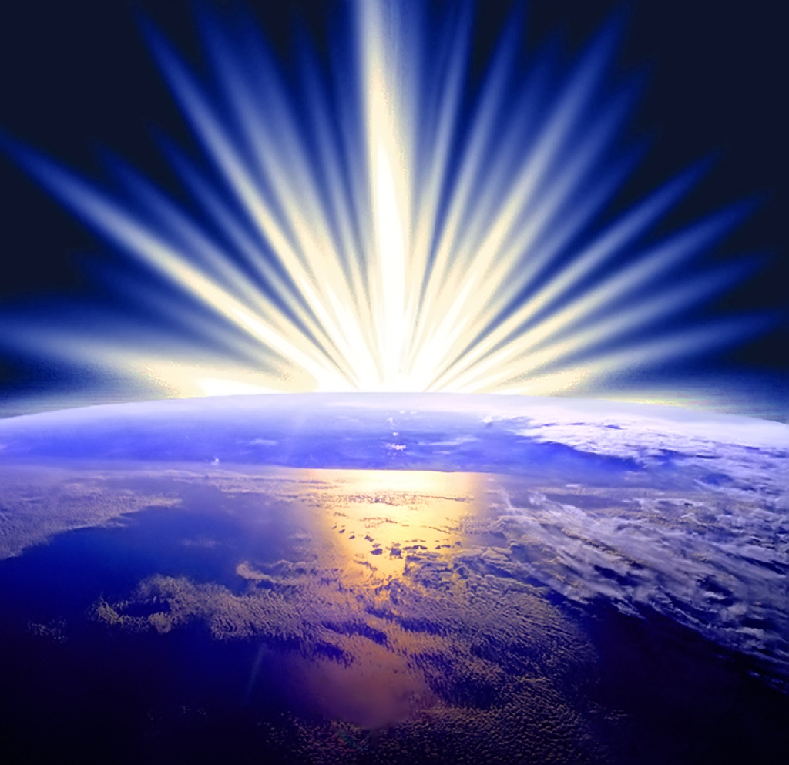
Light Promised
Isaiah 60.1-2
Arise, shine; for thy light is come, and the glory of the Lord is risen upon thee.
² For, behold, the darkness shall cover the earth, and gross darkness the people: but the Lord shall arise upon thee, and his glory shall be seen upon thee.

Slide 4
