Slide 1
The Crusades
World History 9e

Slide 2
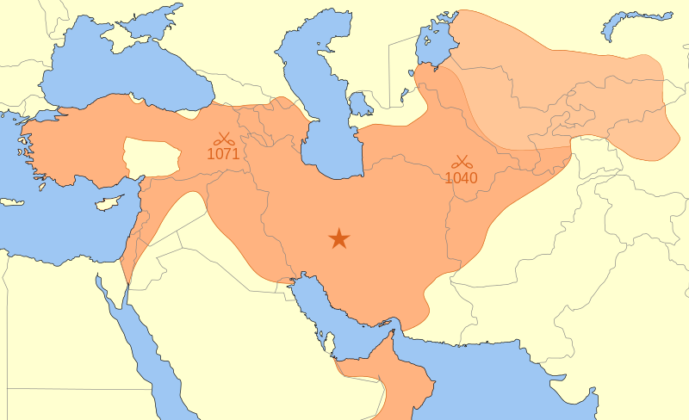
Seljuk Turks Empire (Muslim)
Background: The cruelty and intolerance of the Seljuk Turks sparked the call for the Crusades.

Slide 3
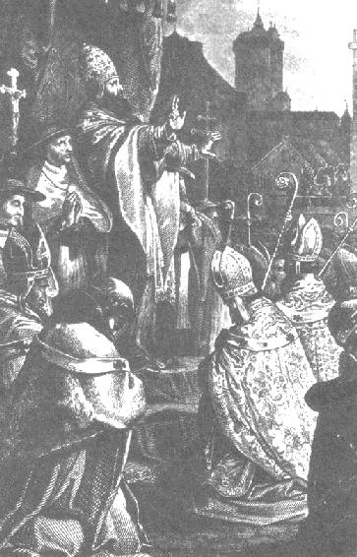
The Call for Crusades
In 1095, Pope Urban II called for Europeans to rally together and retake the “Holy Lands”
He proclaimed that this campaign was the “will of God”
Those who participated were promised:
Forgiveness for sins
Criminal pardons
Eternal life

Slide 4
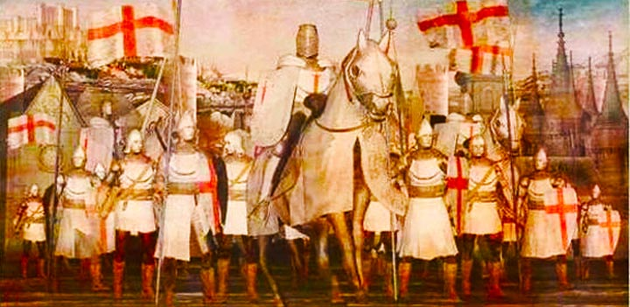
First crusade
Notes:
Add map of the first crusade.

Slide 5
Temporary “Christian” states
Notes:
Add map of the “Christian states” claimed after the first crusade.

Slide 6
Crusades
Notes:
Add map of crusades following the first one.

Slide 7
Long-term Consequences of Crusades
Long-term bitterness and animosity between Muslims and Christians
Weakened the feudal structure of the Middle Ages
Expanded the commercial activity of Europe, contributing to the growth of cities and the middle class
Expanded the horizons of Europeans

Slide 8
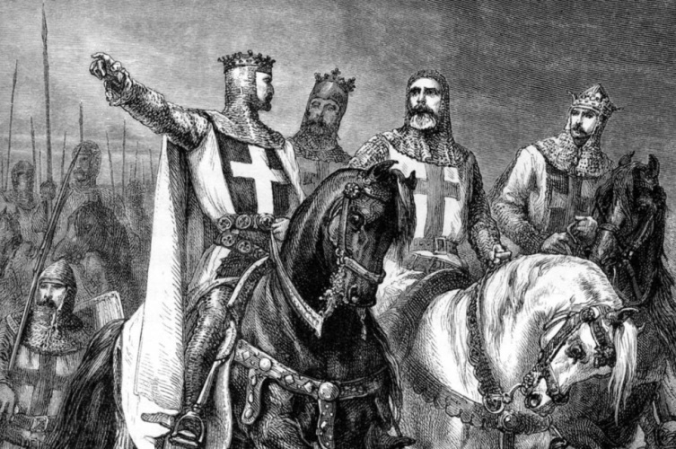
Crusades Overview
Time frame: 1100-1300
Description: Eight military expeditions of Europeans attacking Muslims in the Holy Lands
Purpose: To remove the Holy Lands from Muslim control and put them underneath “Christian” control
Result: Short-term success; long-term failure

