Slide 1
Notre Dame Cathedral
Under construction in medieval Paris, France from 1160-1240’s

Slide 2
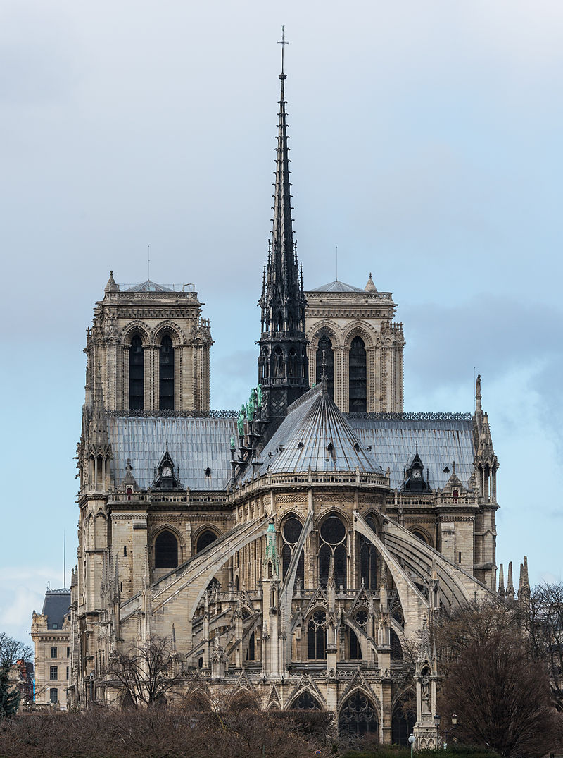
Notes:
Daniel Vorndran / DXR, Notre Dame de Paris, East View 140207 1, CC BY-SA 3.0

Slide 3
Jean De Chelles
A master mason and sculptor created the stained-glass rose window on the Notre Dame

Slide 4
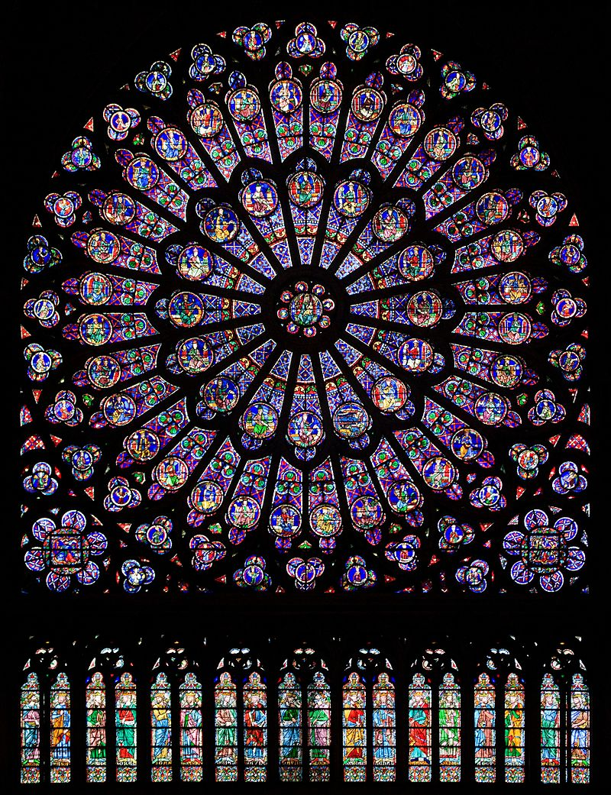
Medieval Artwork
Stained-Glass Rose Window
Notes:
https://commons.wikimedia.org/wiki/File:North_rose_window_of_Notre-Dame_de_Paris,_Aug_2010.jpg

Slide 5
More Rose Windows

Slide 6
Stained-Glass Rose Window
in the Abbey of St Denis, Paris
Notes:
https://commons.wikimedia.org/wiki/File:St_Denis_North_a.jpg

Slide 7
Interior of a rose window at Strasbourg Cathedral in Strasbourg, Alsace, France
Notes:
Photo is public domain

Slide 8
Flamboyant window in Sens Cathedral in eastern France
Notes:
Photo is public domain

Slide 9
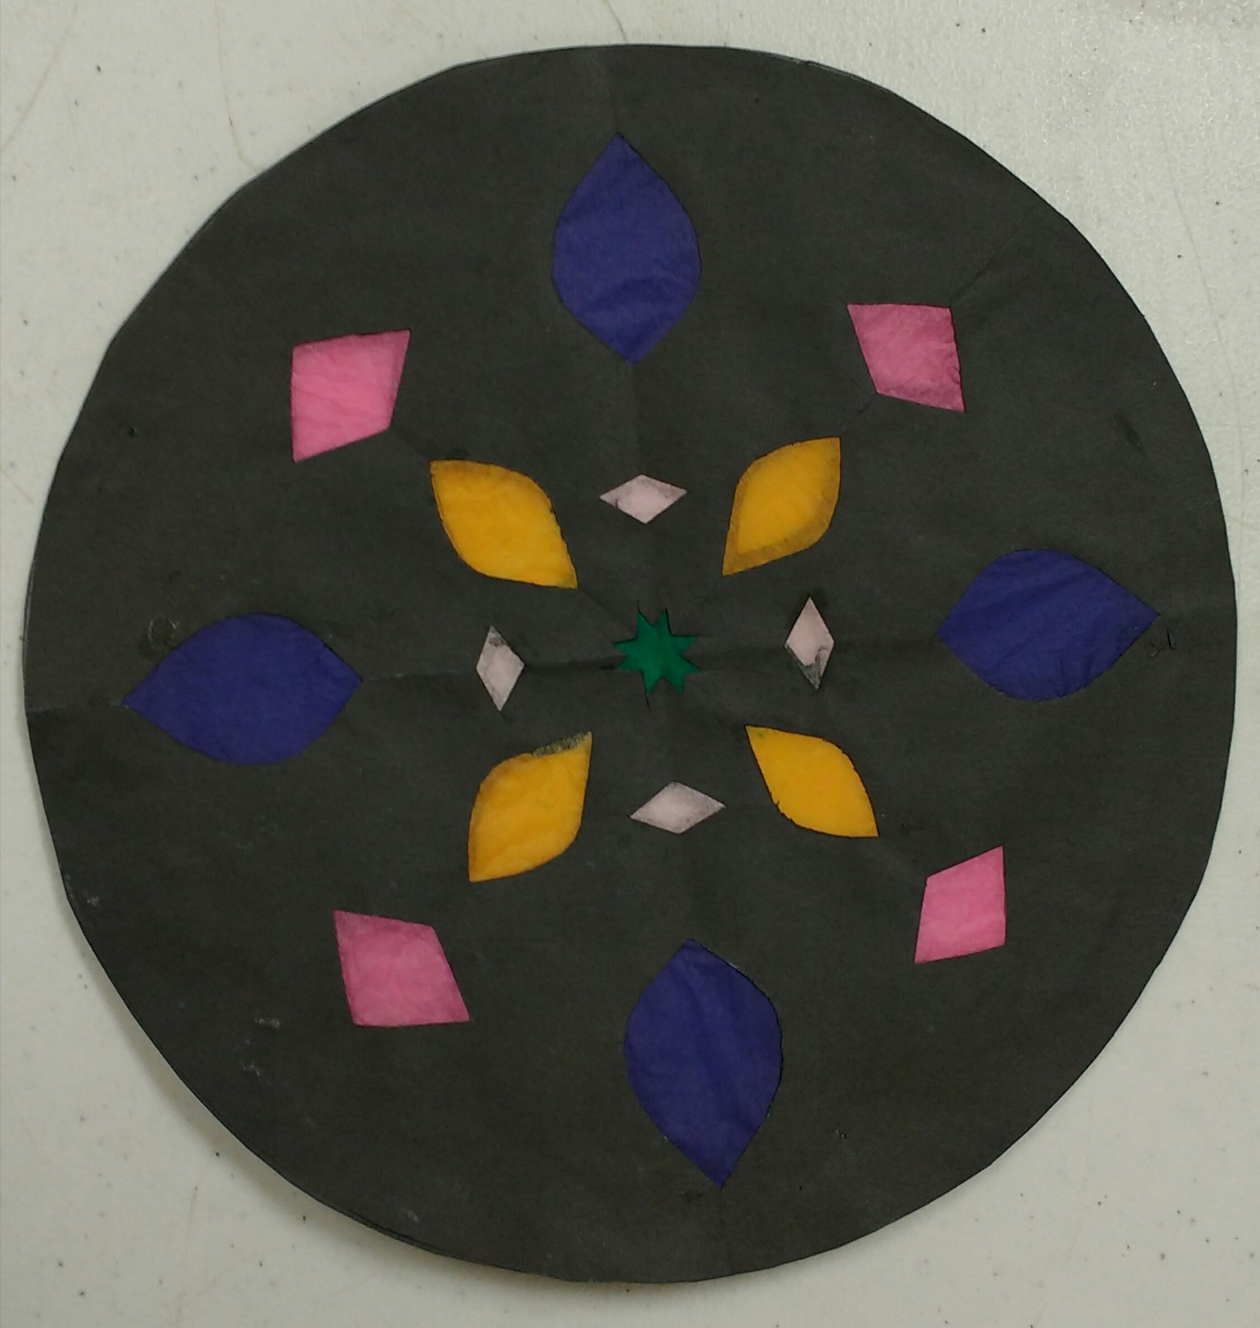

Slide 10
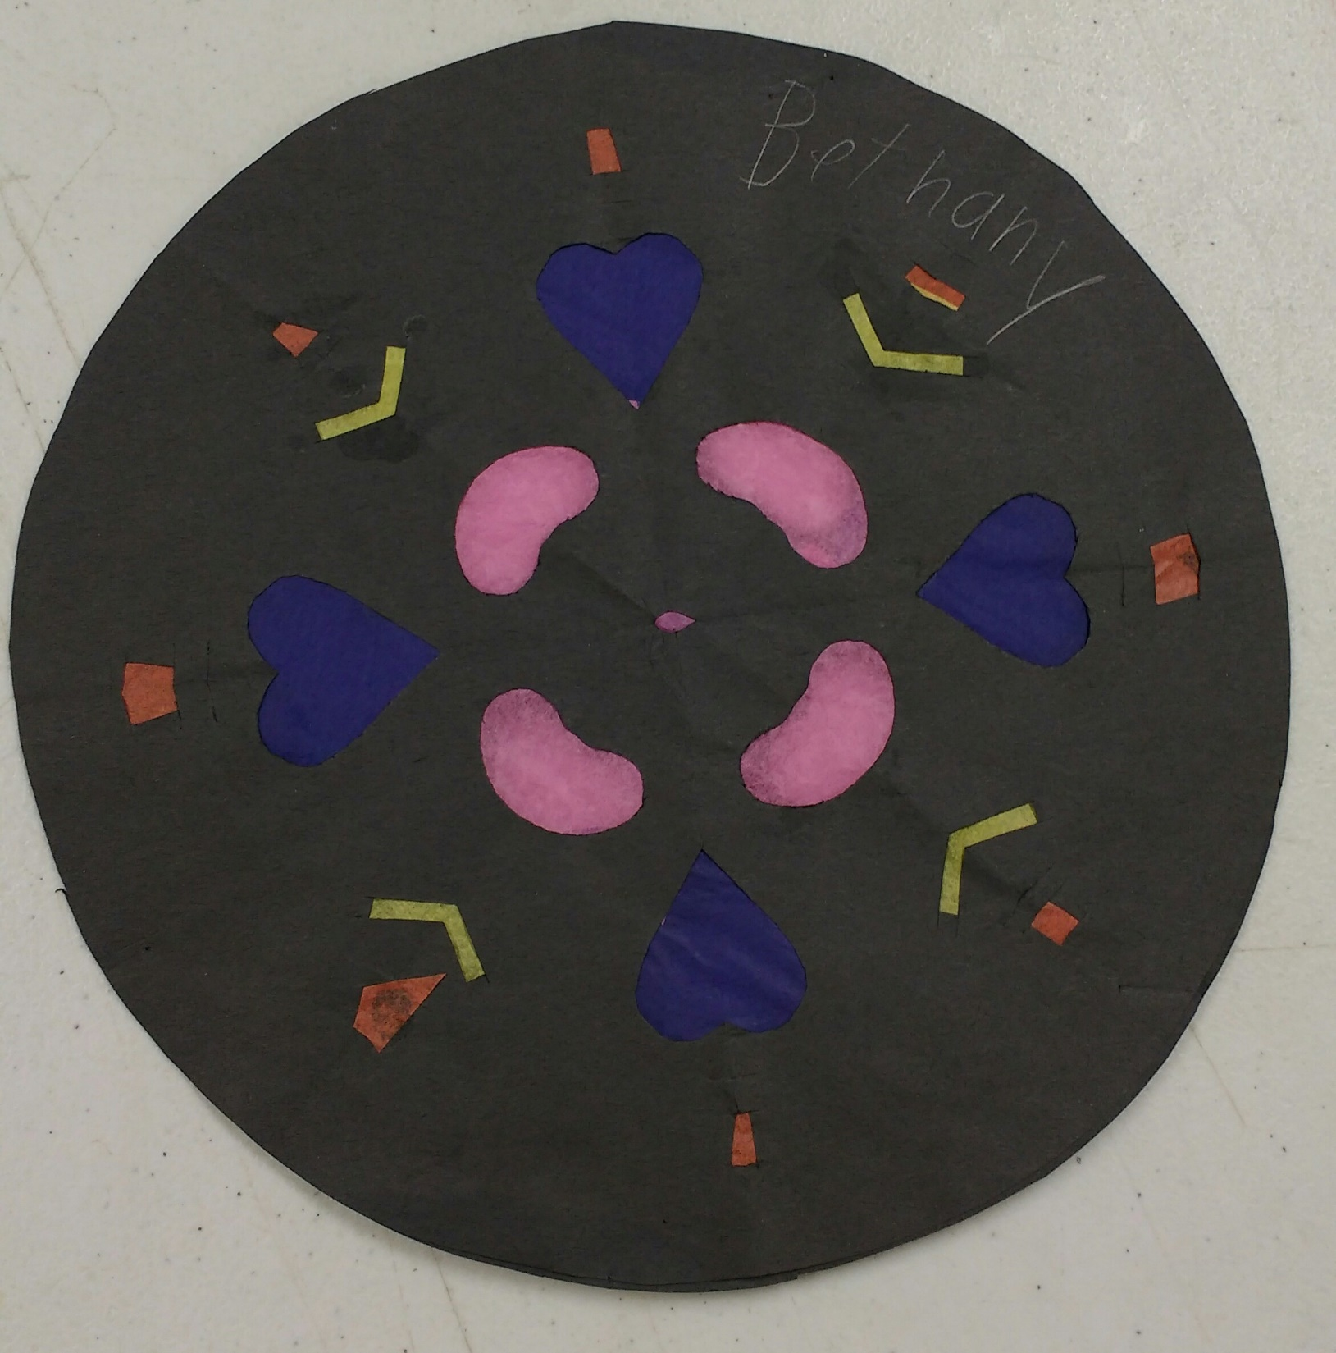

Slide 11
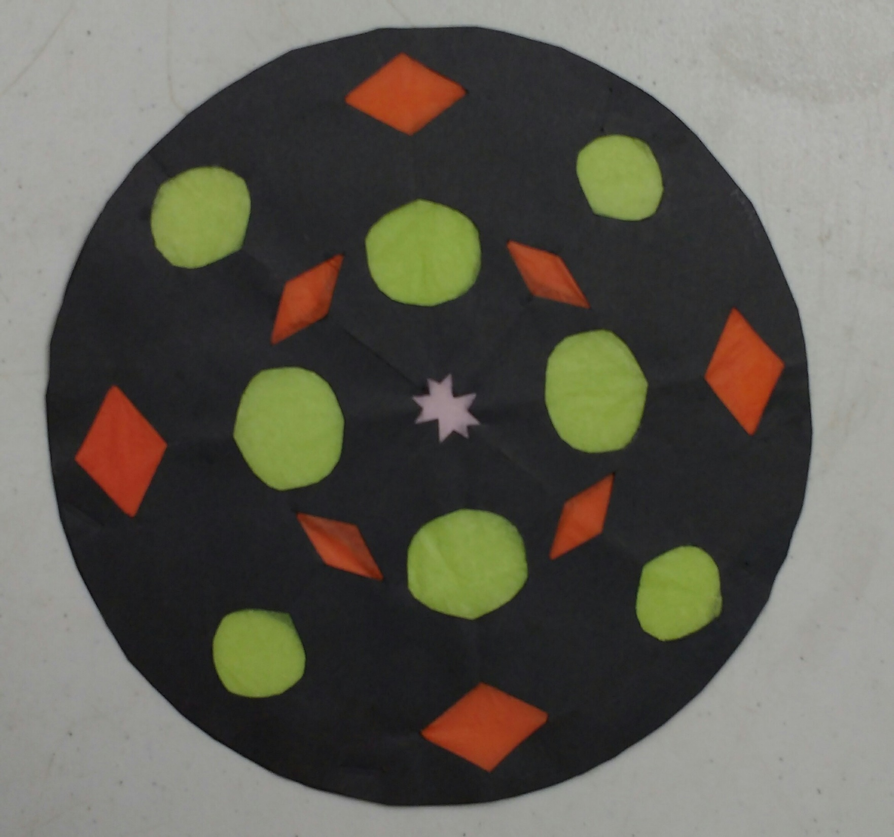

Slide 12
