Slide 1
The REnaissance
MONA LISA – BY LEONARDO DA VINCI

Slide 2
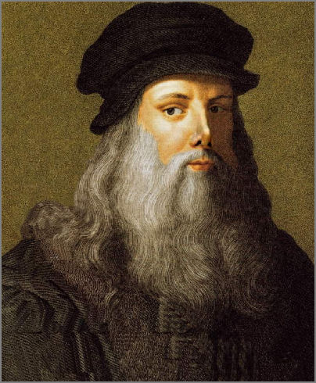
the Renaissance 1500-1688 AD
Leonardo da Vinci was a renaissance man.

Slide 3
Leonardo da Vinci
Da Vinci was . . .
A painter and artist
A scientist
An architect
An inventor
A musician
A mathematician

Slide 4
Famous Paintings by da Vinci
The Mona Lisa
The Last Supper
And many more!

Slide 5
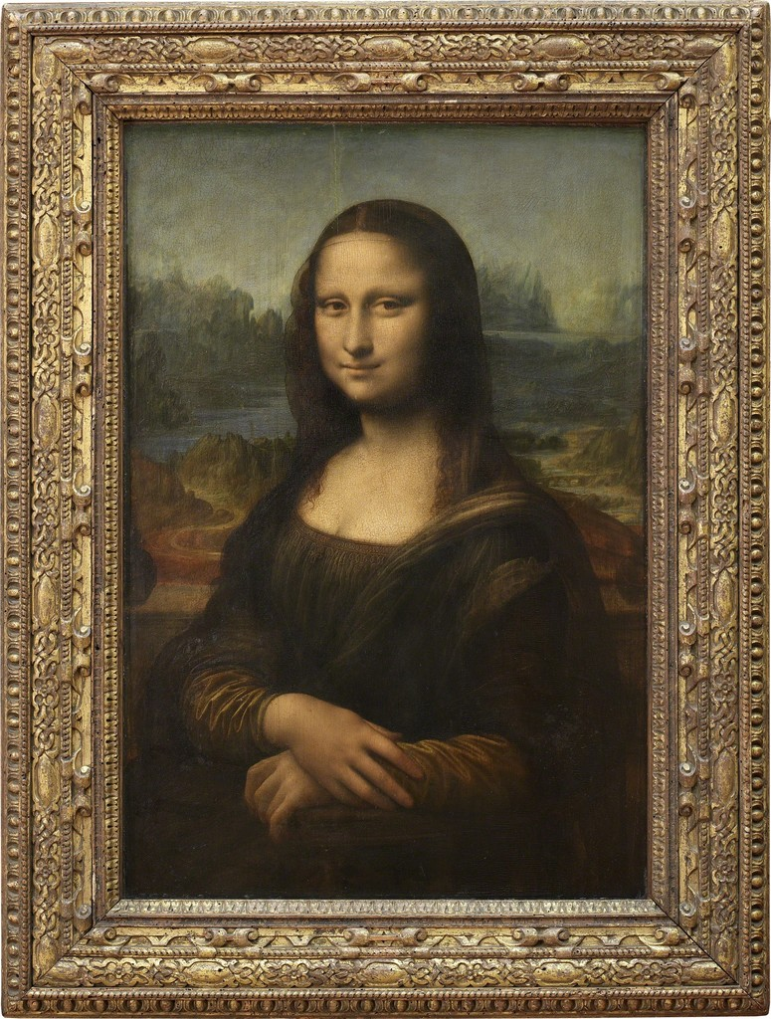

Slide 6
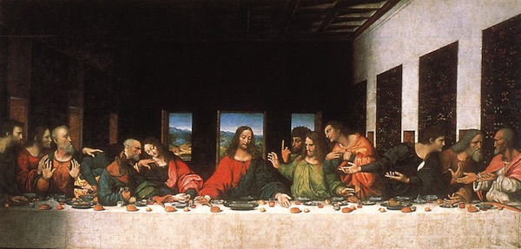

Slide 7
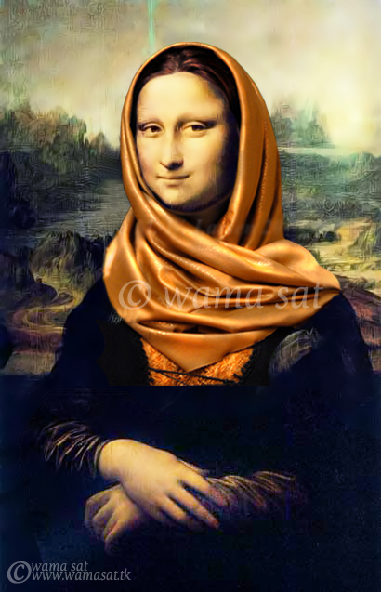
Parodies of Mona Lisa
Image by wamasat at deviantart.com
Licensed under CC 3.0.

Slide 8
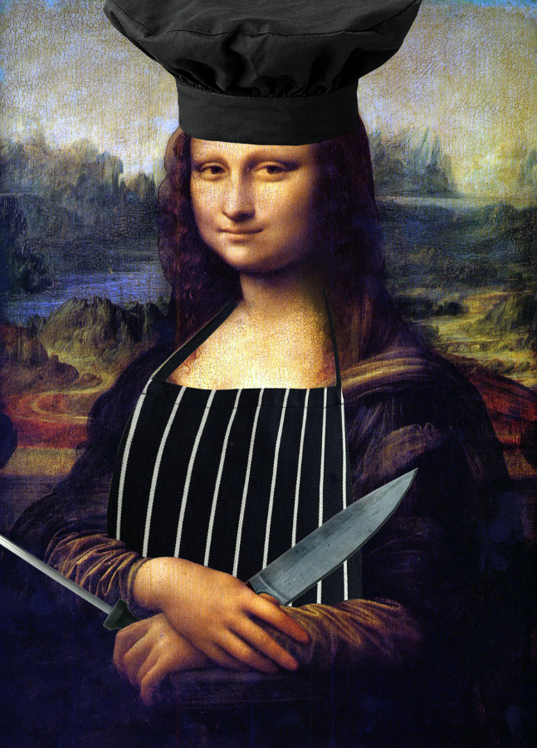
Image by FearOfTheBlackWolf at deviantart.com
Licensed under CC 3.0.

Slide 9
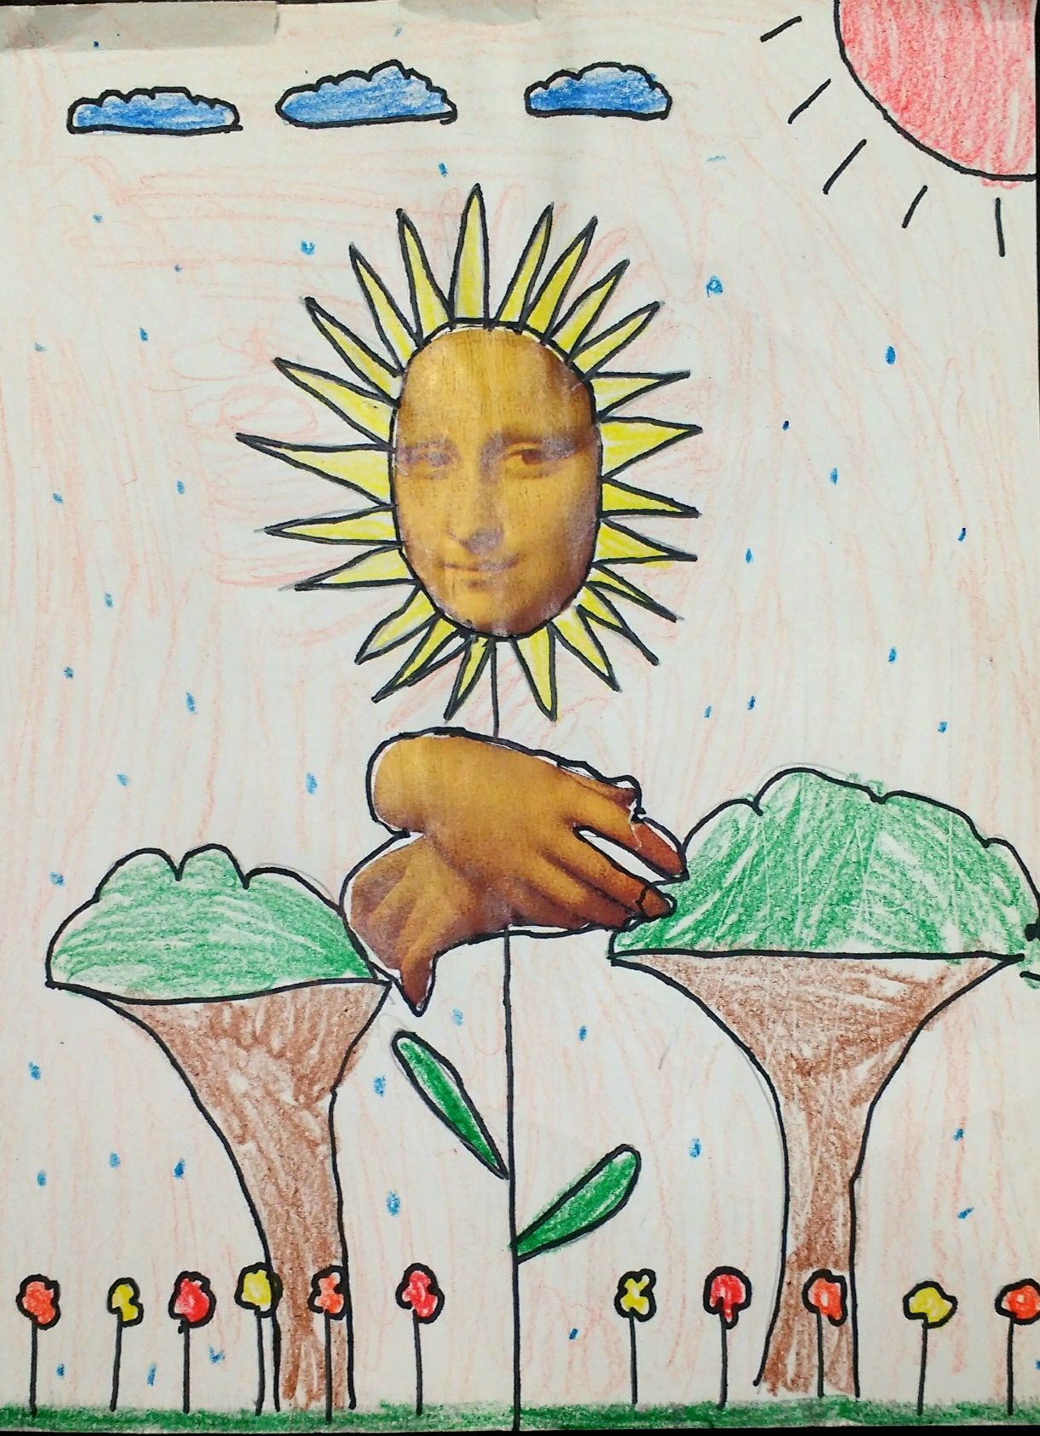
Notes:
To the teacher: you may wish to include examples of student art from http://artwithmrsseitz.blogspot.com/2013/02/mona-lisa-parodies.html

Slide 10
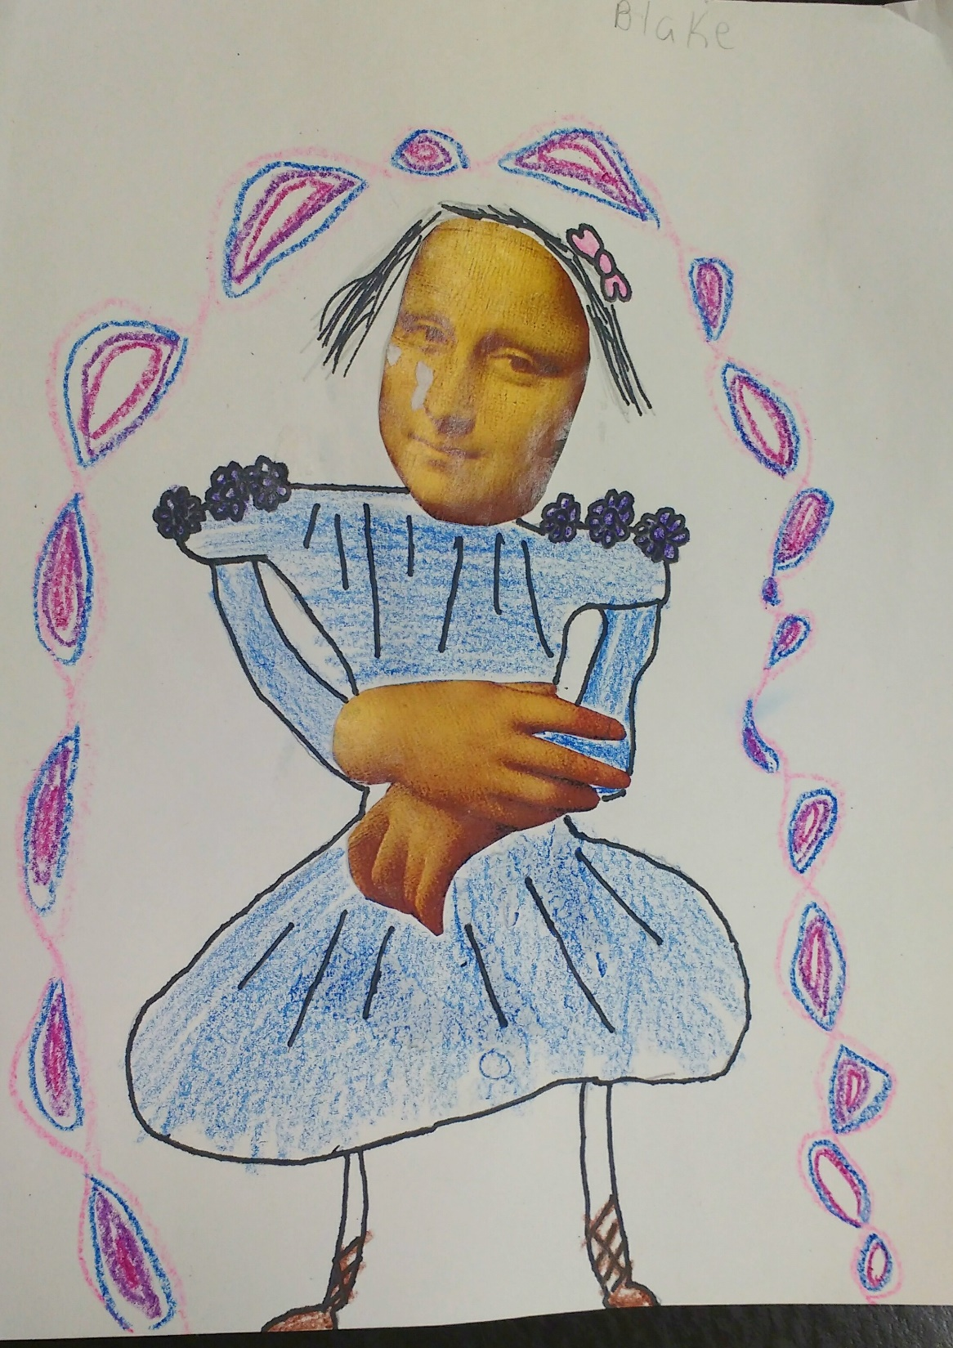
Notes:
To the teacher: you may wish to include examples of student art from http://artwithmrsseitz.blogspot.com/2013/02/mona-lisa-parodies.html

Slide 11
Now it’s your turn!
Cut out the hands and face of Mona Lisa.
Draw and color a parody of Mona Lisa.

