Slide 1
Romanticism
1780-1850 AD

Slide 2
Romantic = an idealized view of reality.

Slide 3
Romanticism art
Romantic art focused on emotions, feelings, and moods of all kinds including spirituality, imagination, mystery, and fervor. The subject matter varied widely including landscapes, religion, revolution, and peaceful beauty. The brushwork for romantic art became looser and less precise. The great Romantic artist Caspar David Friedrich summed up Romanticism saying "the artist's feeling is his law".
Read more at: http://www.ducksters.com/history/art/romanticism.php

Slide 4
Romanticism Art
It was one of the first times in the history of art that landscapes became a significant subject for painting.

Slide 5
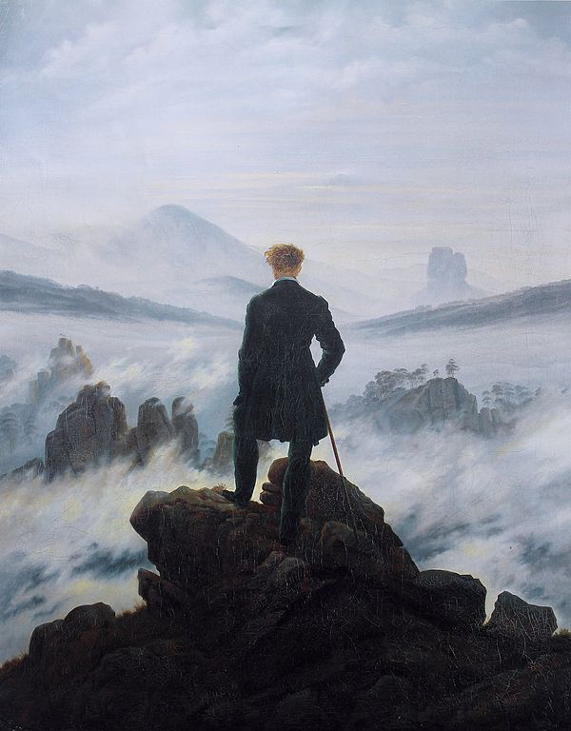
The Wanderer Above Sea and Fog by Caspar David Friedrich

Slide 6
The Wanderer Above Sky & Sea
Perhaps no painting represents the Romanticism movement better than Friedrich's The Wanderer. In this picture a man stands at the peak of a rocky precipice, his back to the viewer as he looks out over the clouds and the world. The viewer experiences the awe of nature and at the same time feels the insignificance of man. The painting does an excellent job of conveying the emotion of a moment and the drama of nature.

Slide 7
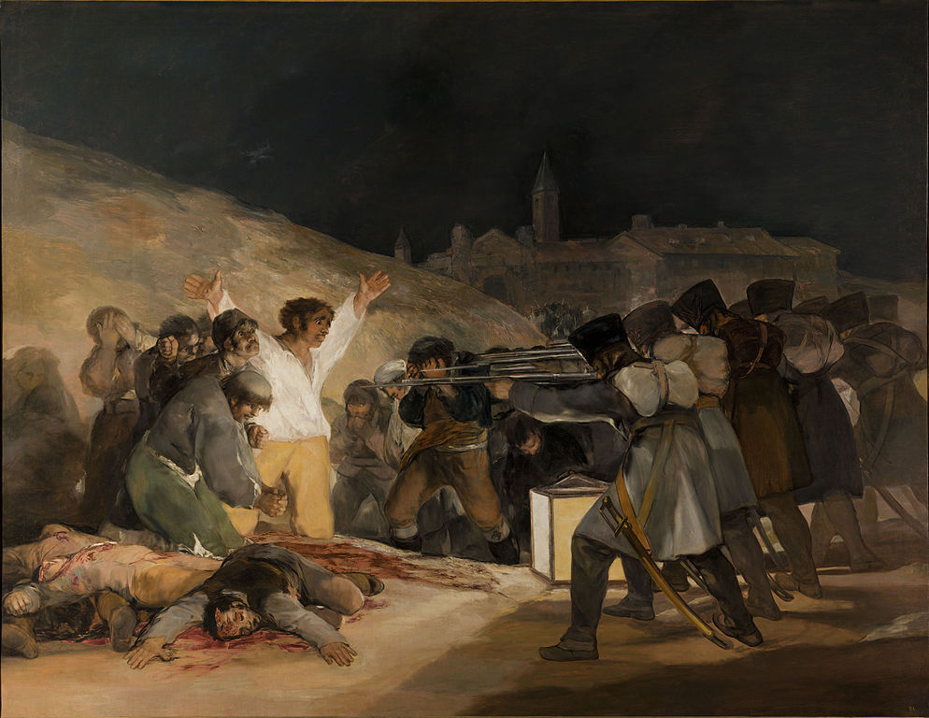
The Third of May by Francisco Goya

Slide 8
The Third of May
The Third of May 1808 shows a different side of the Romantic artist, the side of revolution. In this painting Francisco Goya is commemorating the Spanish resistance to France and the armies of Napoleon. This painting has movement, drama, and emotion typical of the Romantic Era. It is also one of the first paintings used to protest the horrors of war.

Slide 9
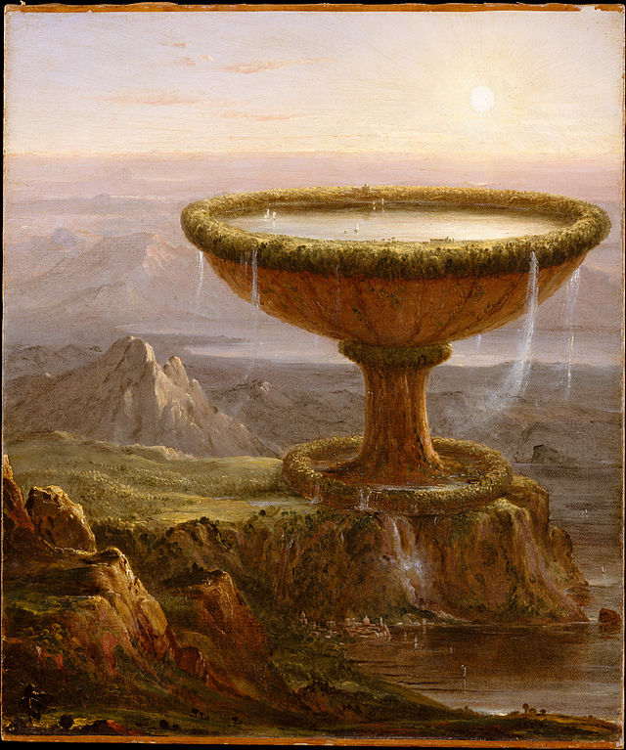
The Titan’s Goblet by Thomas Cole

Slide 10
The Titan’s Goblet
In this painting you can see the sense of the fantastic. The Titans were from Greek Mythology. They were giants who ruled before the Greek gods like Zeus. The sheer size of the goblet gives you an idea as to how enormous the Titans must have been. Details in the painting, such as the boats sailing inside the goblet and the buildings on the rim of the goblet, add to the feeling of grandeur.

Slide 11
Elements of Art:
Line (thin, thick, zigzag, curved, __?___etc.)
Shape (_____?_____and ______?_____)
Color (Monochromatic)
Form
Value
Space
Texture

Slide 12
Monochromatic - Colored Landscape
Several layers of mountain in the background
One or more layers of architecture
One color is used
Layers are shown by tinting (white added to color) or shading (black added to color)
Idealistic

Slide 13
