Slide 1
Ukiyo-e
Japanese Print Making

Slide 2
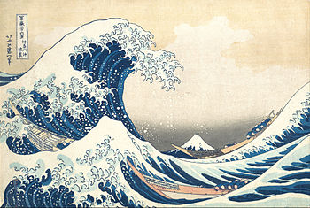
The Great Wave by Hokusai by Hokusai

Slide 3
The Great Wave Facts:acts:
The first print in Hokusai’s series Thirty-six Images of Mount Fuji (1829-1833)
The image depicts an enormous wave threatening boats off the coast of the town of Kanagawa (the present-day city of Yokohama, Kanagawa Prefecture)
A woodblock print by the Japanese ukiyo-e artist Hokusai
Hokusai’s art influenced Post-Impressionism

Slide 4
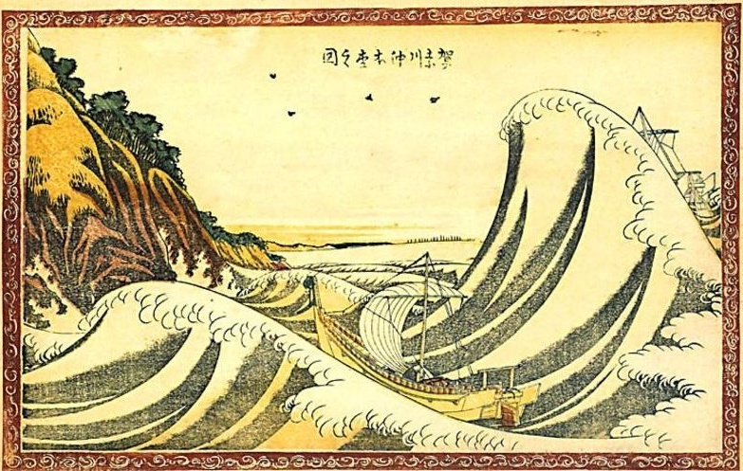
View of Honmoku off Kanagawa by Hokusai by Hokusai

Slide 5
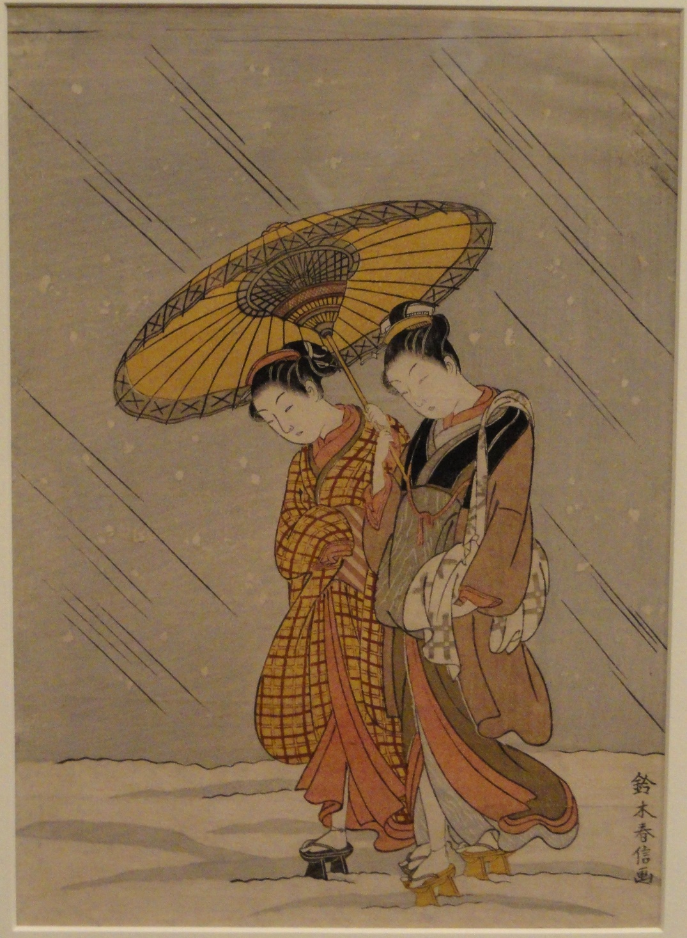
Couple in a Snowstorm by Harunobu (1768) by Hokusai

Slide 6
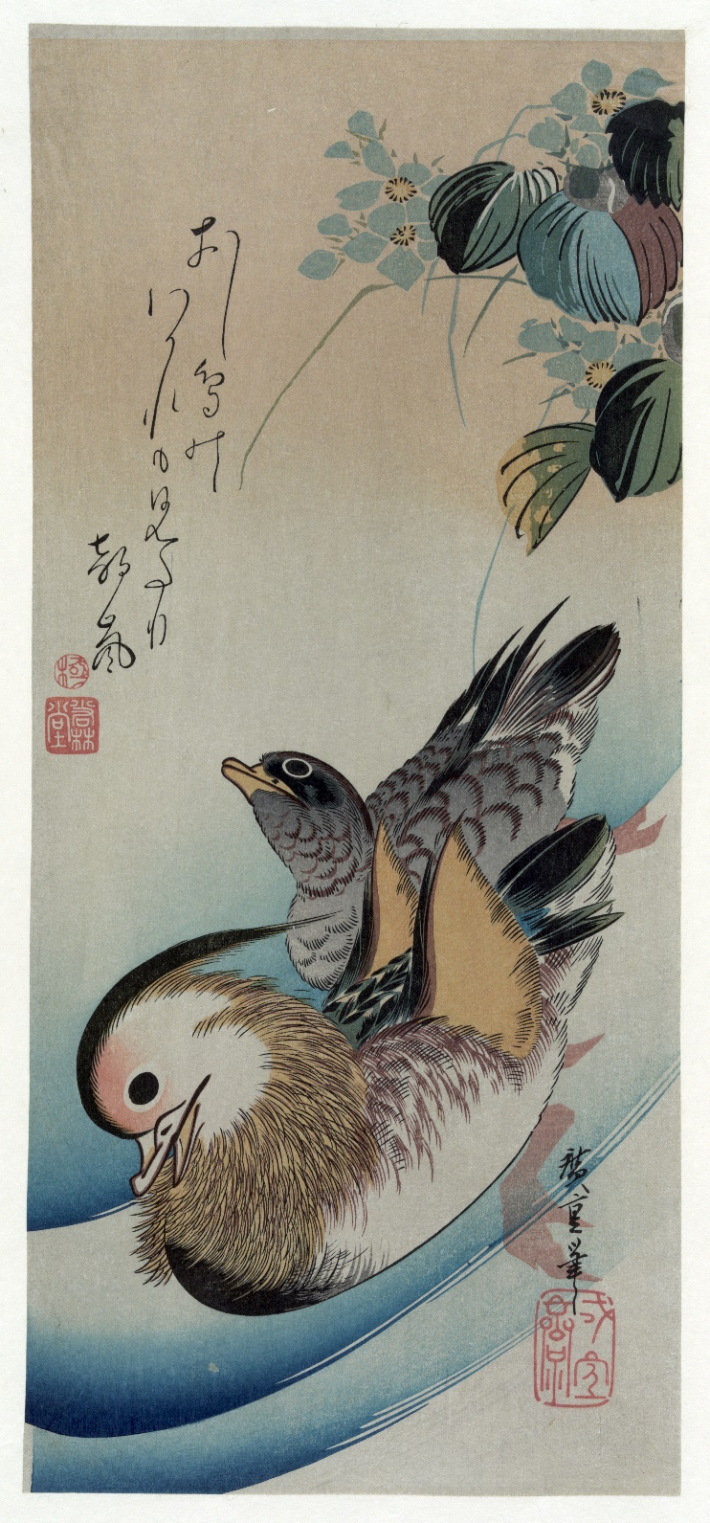
Two Mandarin Ducks by Hiroshige (1838) by Hokusai

Slide 8
The Great Wave by Hokusai by Hokusai

