Slide 1
Post Impressionism
1885-1910

Slide 2
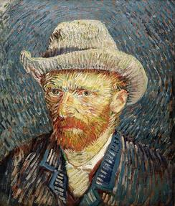
Self-Portrait of Vincent van Gogh (1889)

Slide 3
Post Impressionism Facts:
A soft reaction to Impressionism (1885-1910)
Instead of depicting color and light, they used color and shape to create more structure, order, and optical effects in painting
“The movement ushered in an era during which painting transcended its traditional role as a window onto the world and instead became a window into the artist's mind and soul.” (Focus on memories and emotions)
Leaned toward abstraction
Influenced by Japanese wood block prints called Ukiyo-e

Slide 4
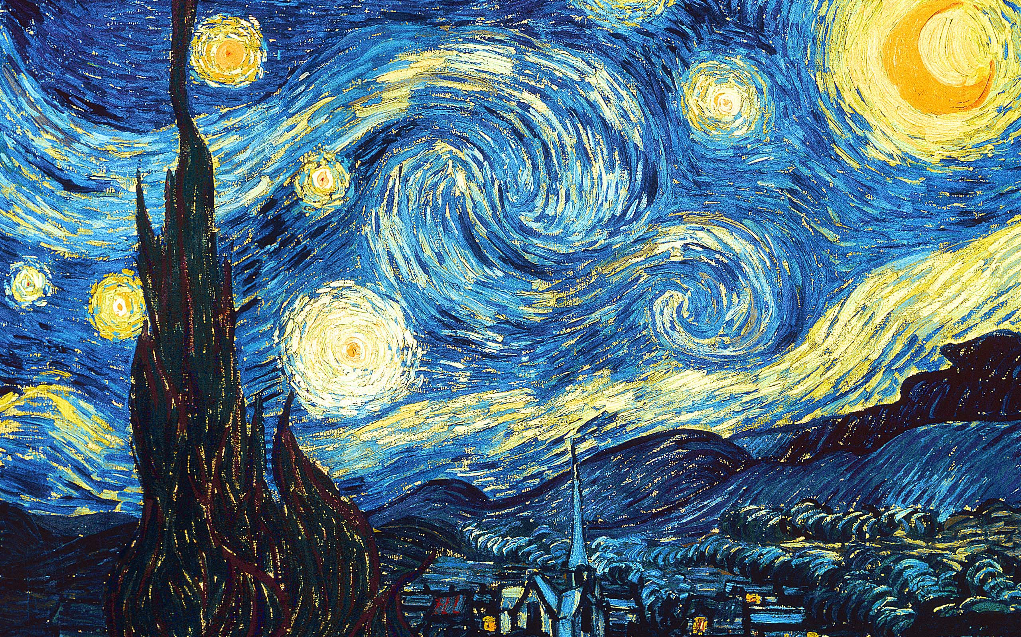
Starry Night (1889) by Vincent van Gogh

Slide 5
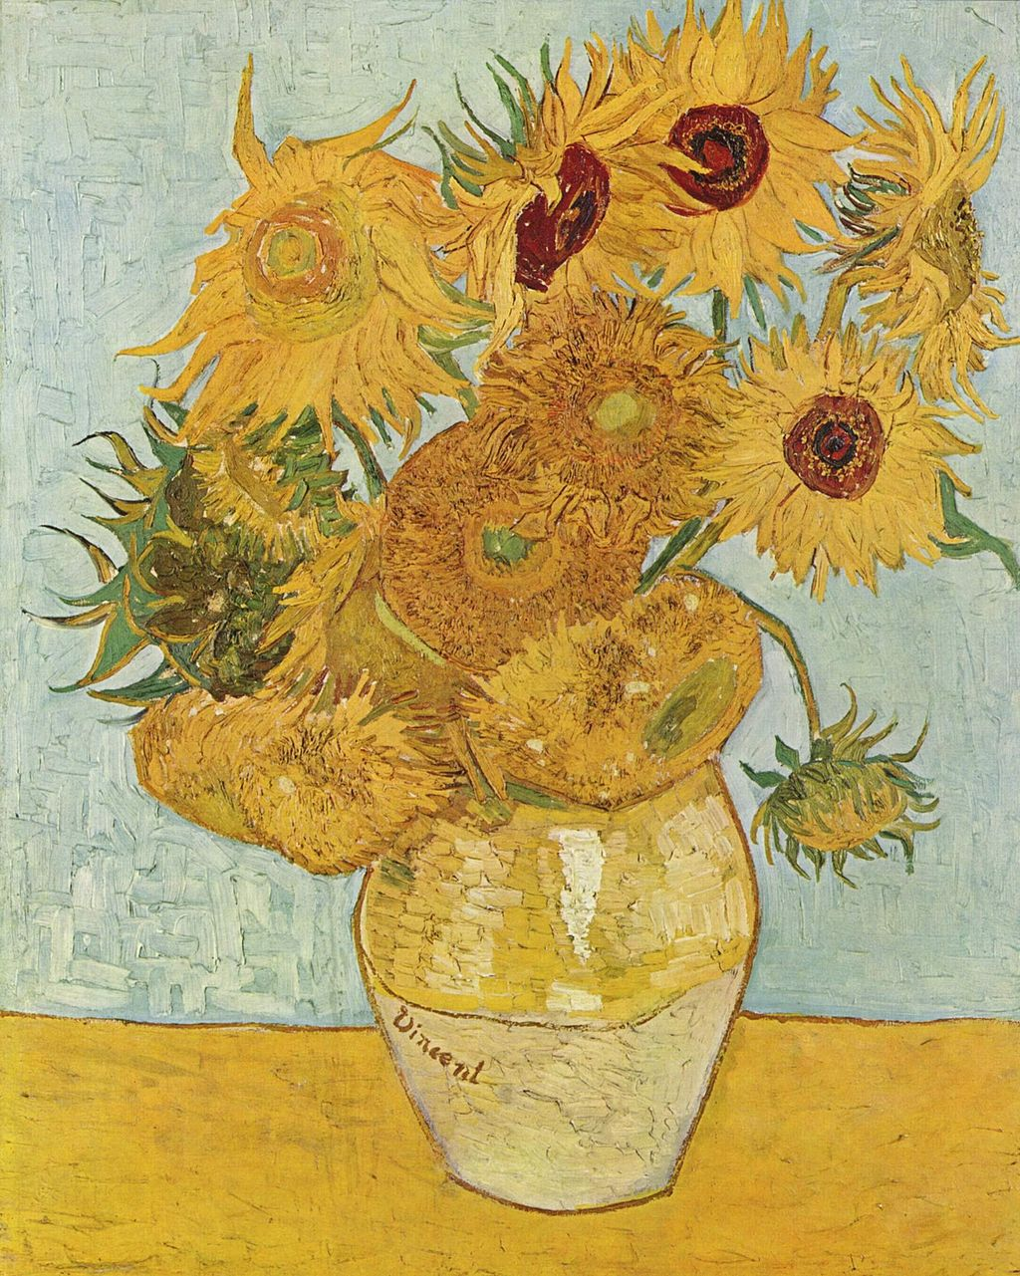
Vase with Twelve Sunflowers (1888) by Vincent van Gogh

Slide 6
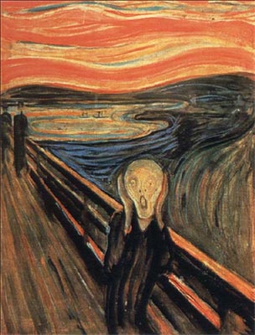
The Scream (1893) by Edvard Munch
"Nature is not only all that is visible to the eye...It also includes the inner pictures of the soul."

Slide 7
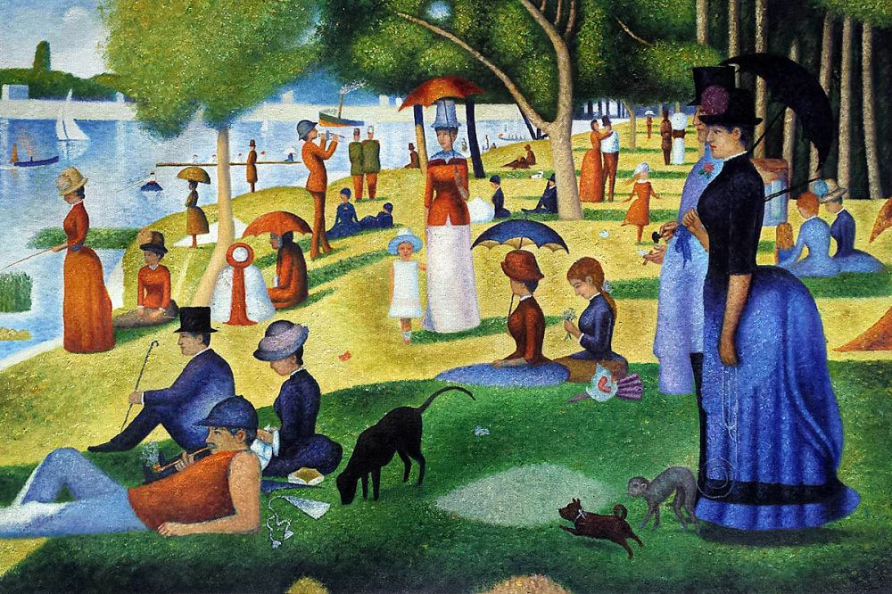
Sunday Afternoon (Pointillism)(1886) Georges Seurat

Slide 8
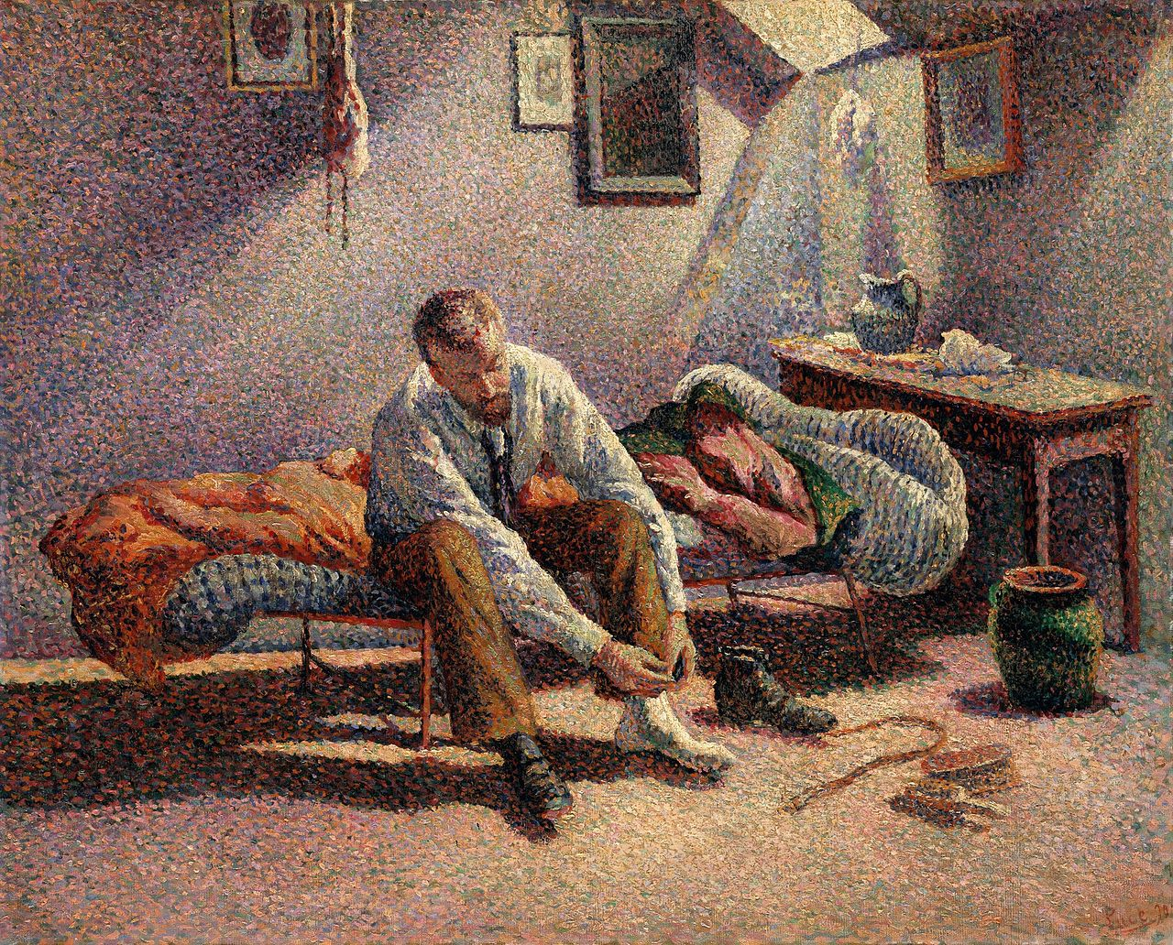
Other examples of Pointillism: Morning, Interior (1890) Maximilien Luce

Slide 9
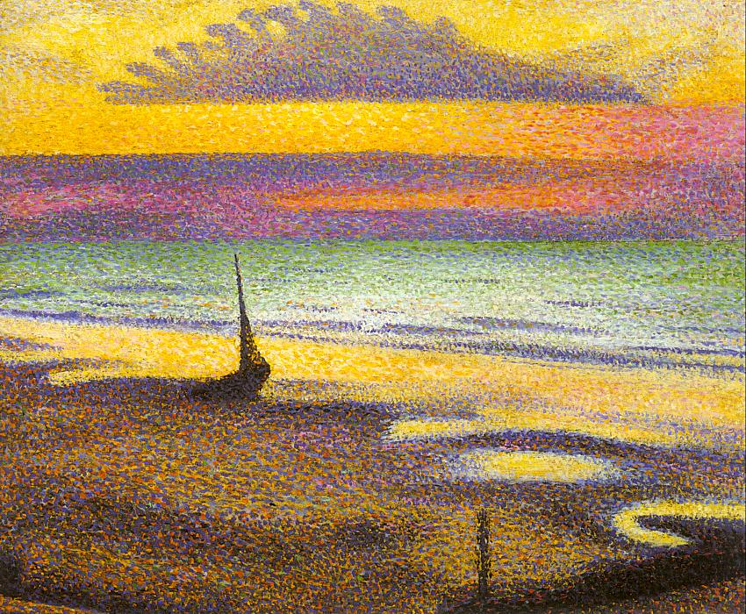
The Beach at Heist (1891-92) Georges Lemmen

