Slide 1
British Colombia
The Westernmost Province

Slide 2
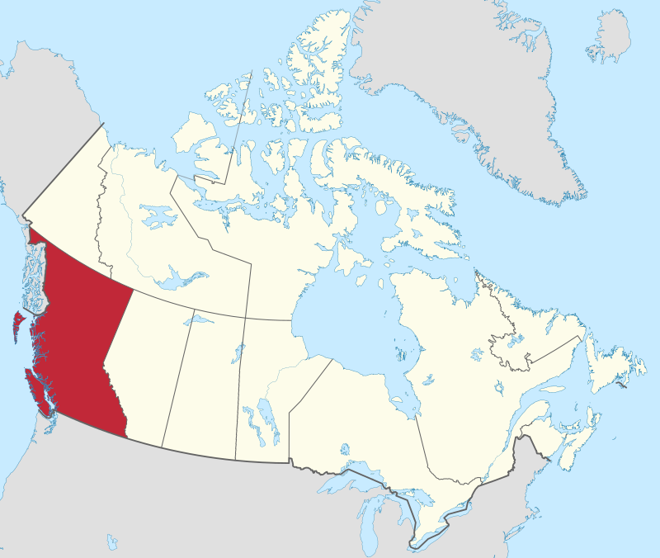
British Columbia
By MapGrid - Own work, CC BY-SA 4.0, https://commons.wikimedia.org/w/index.php?curid=98178301

Slide 3
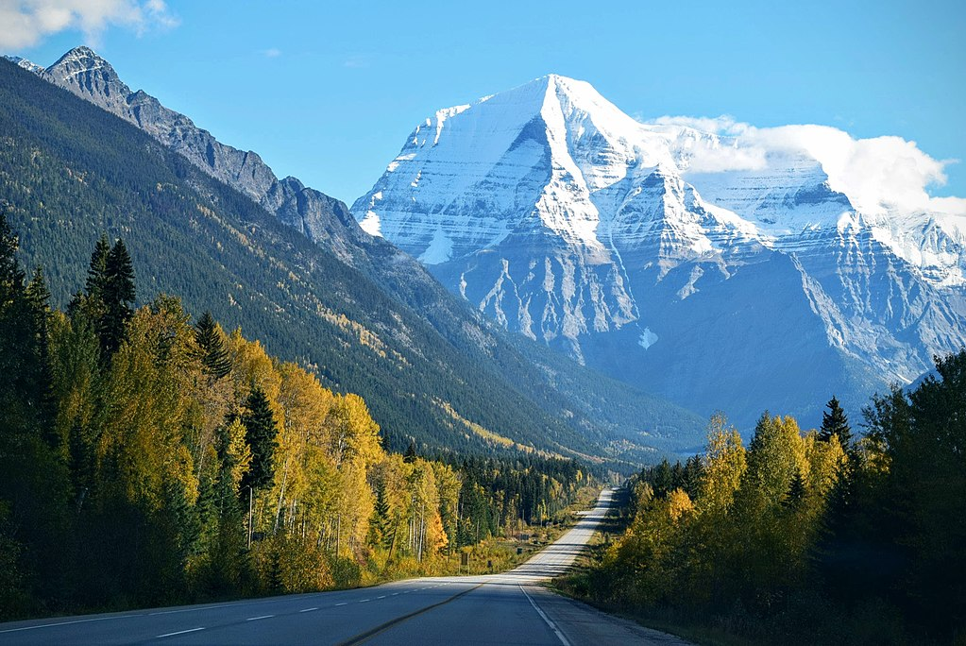
Canadian Rockies
By Tim Gouw punttim - https://unsplash.com/photos/1aL41nYh-8gImageGallery, CC0, https://commons.wikimedia.org/w/index.php?curid=61730190

Slide 4
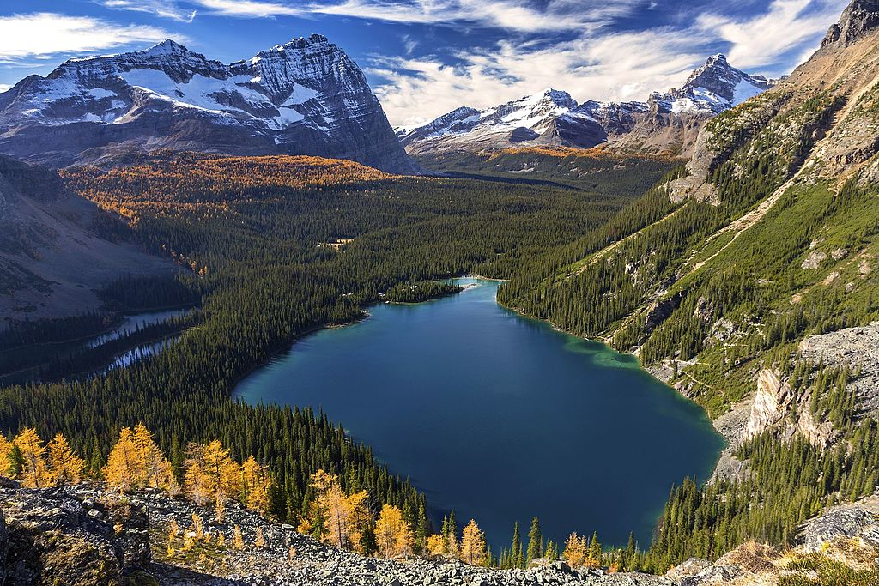
Lake O’hara
By Zeljko Kozomara - Own work, CC BY-SA 4.0, https://commons.wikimedia.org/w/index.php?curid=60010699

Slide 5
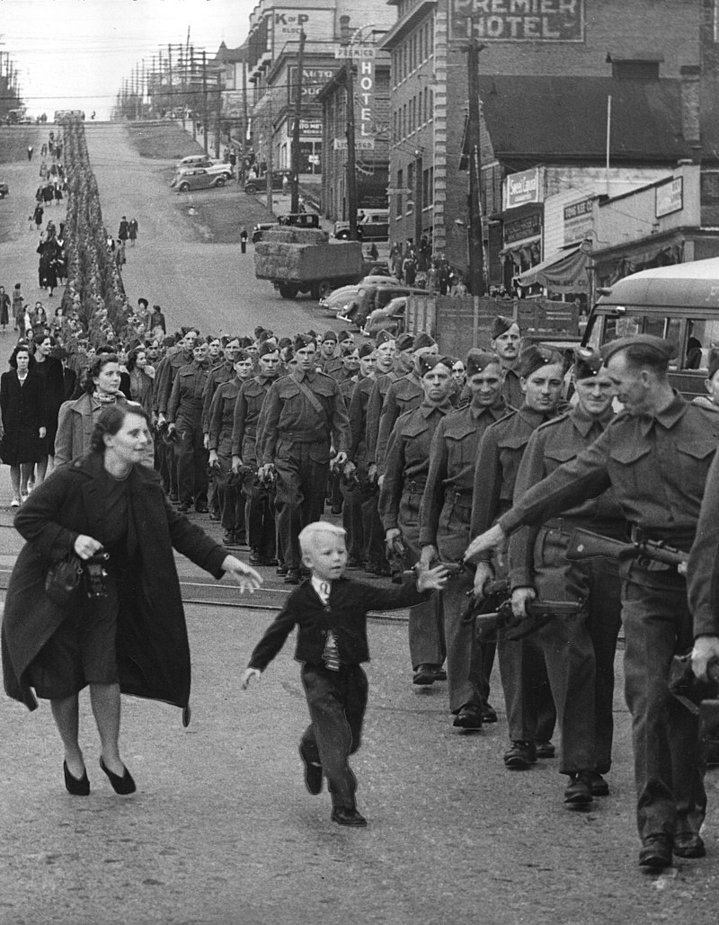
WWII
BC Regiment

Slide 6
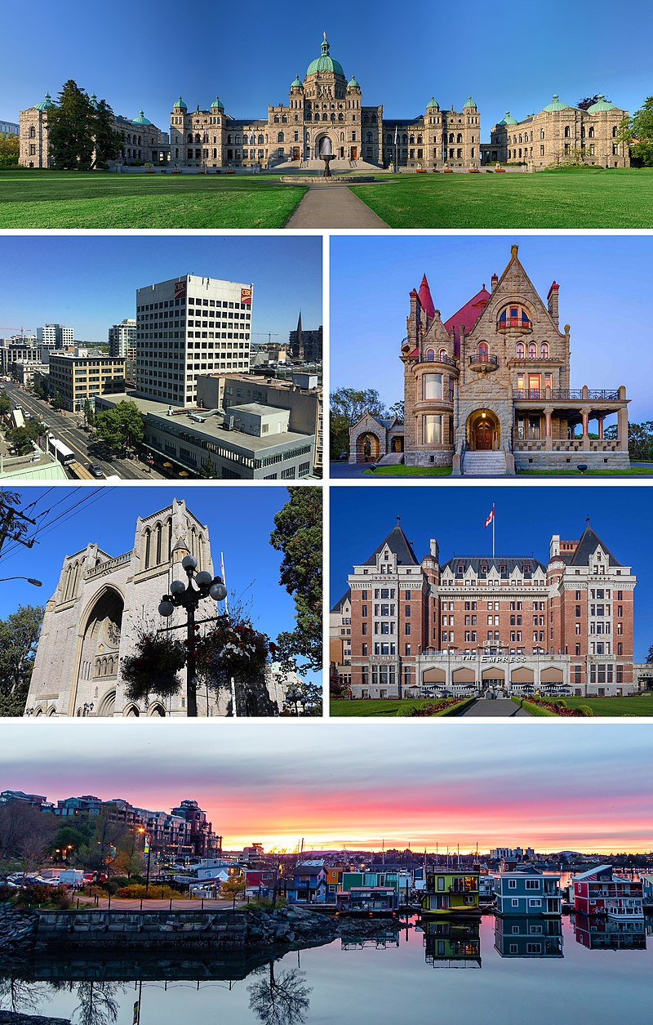
Victoria
Capital of British Colombia
By Allice Hunter - File:British_Columbia_Parliament_Buildings_-_Pano_-_HDR.jpgFile:Victoria_BC_Downtown_skyline.jpgFile:Craigdarroch_Castle_just_after_sunset_-_view_from_the_west,_Victoria,_Canada.jpgFile:Christ_Church_Cathedral_(Victoria,_British_Columbia)_3.jpgFile:Fairmont_Empress,_Victoria,_British_Columbia,_Canada_08.jpgFile:Float Home Village (32765998127).jpg, CC BY-SA 4.0, https://commons.wikimedia.org/w/index.php?curid=90677124

