Slide 1
Texture
You can almost feel this fake chalkboard, can’t you?

Slide 2
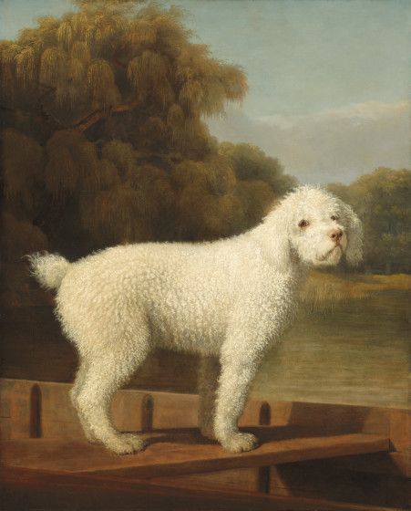
George Stubbs, White Poodle

Slide 3
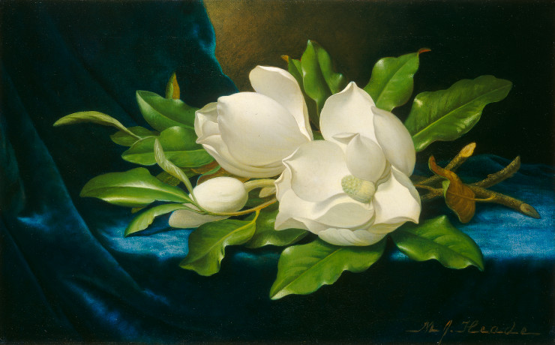
Martin Heade, Giant Magnolias on a Blue Velvet Cloth

Slide 4
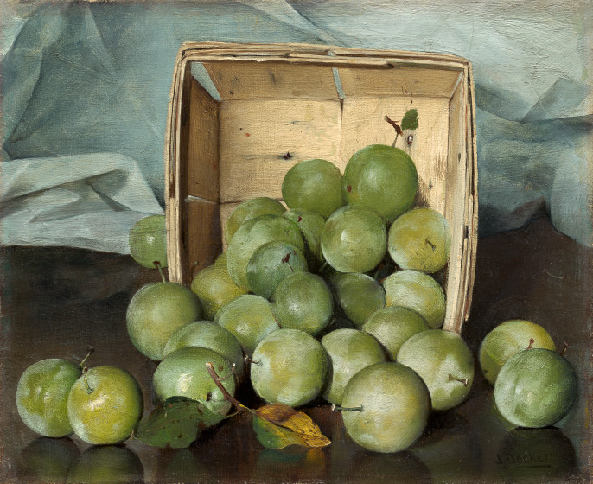
Joseph Decker, Green Plums

