Slide 1
The Line
What’s the big deal with the line anyway?

Slide 2
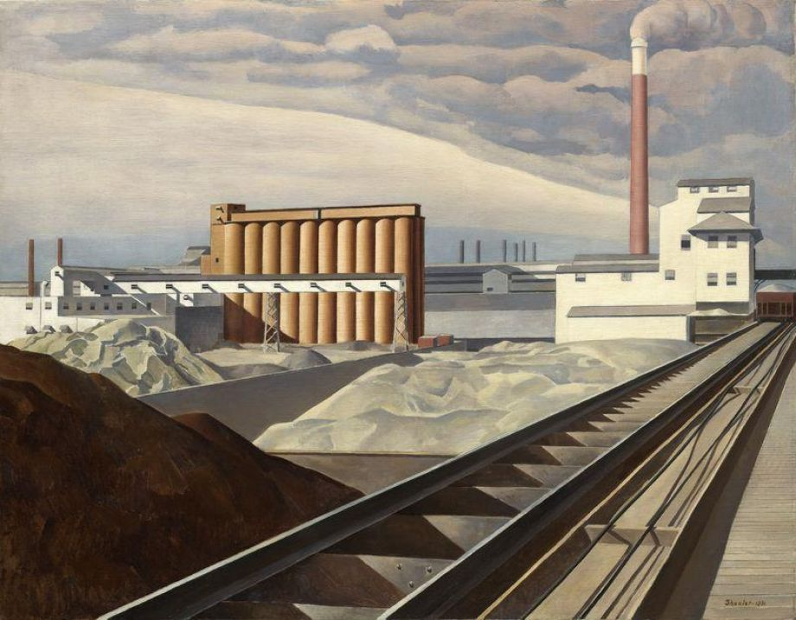
Classic Landscape, Charles Sheeler: 1932

Slide 3
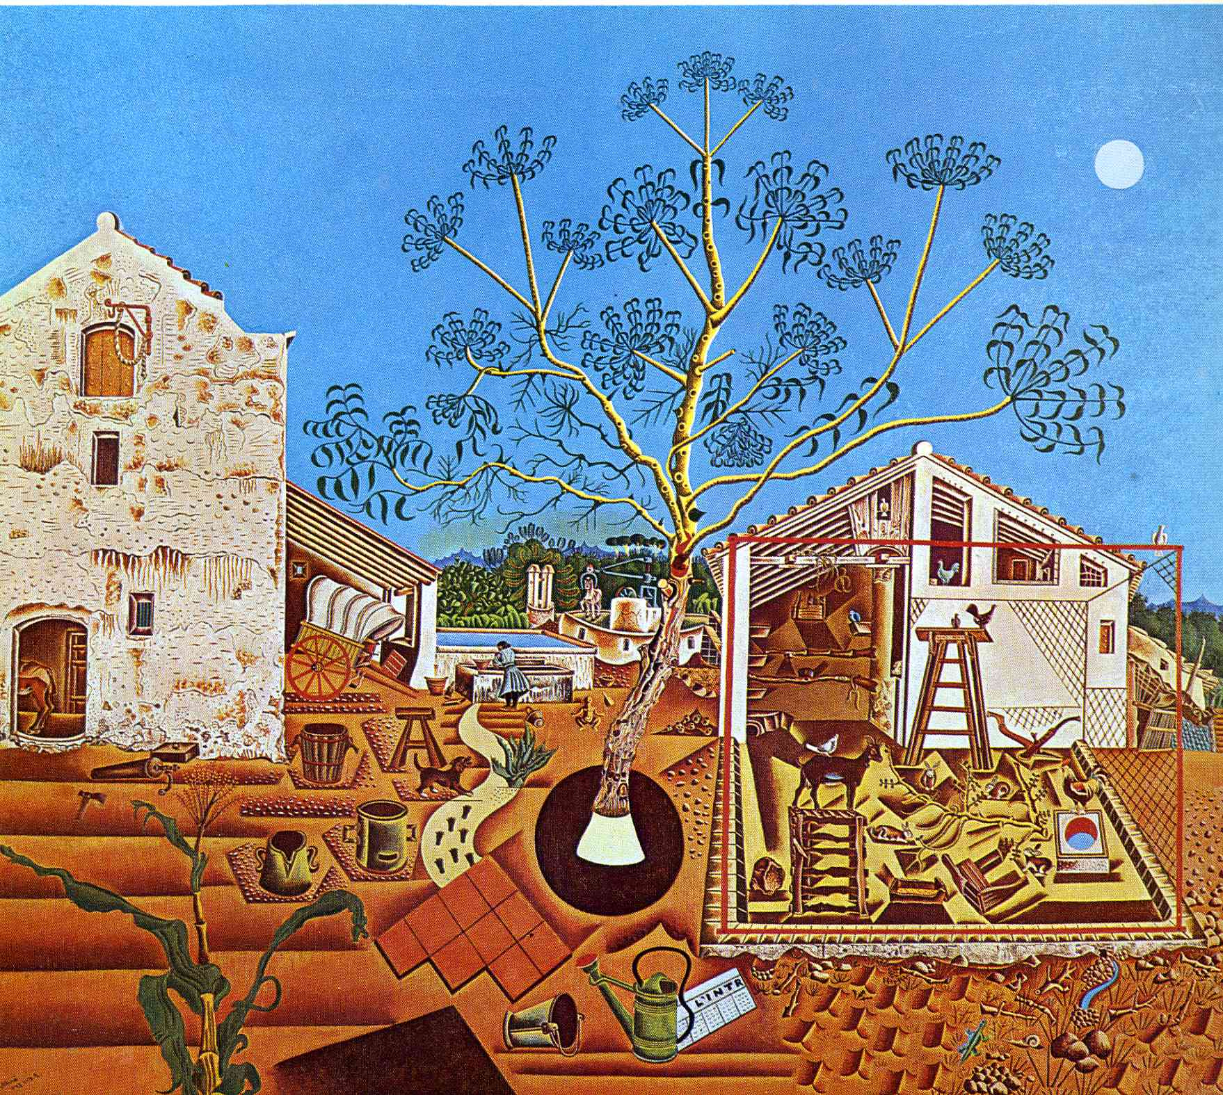
The Farm, Joan Miro

Slide 4
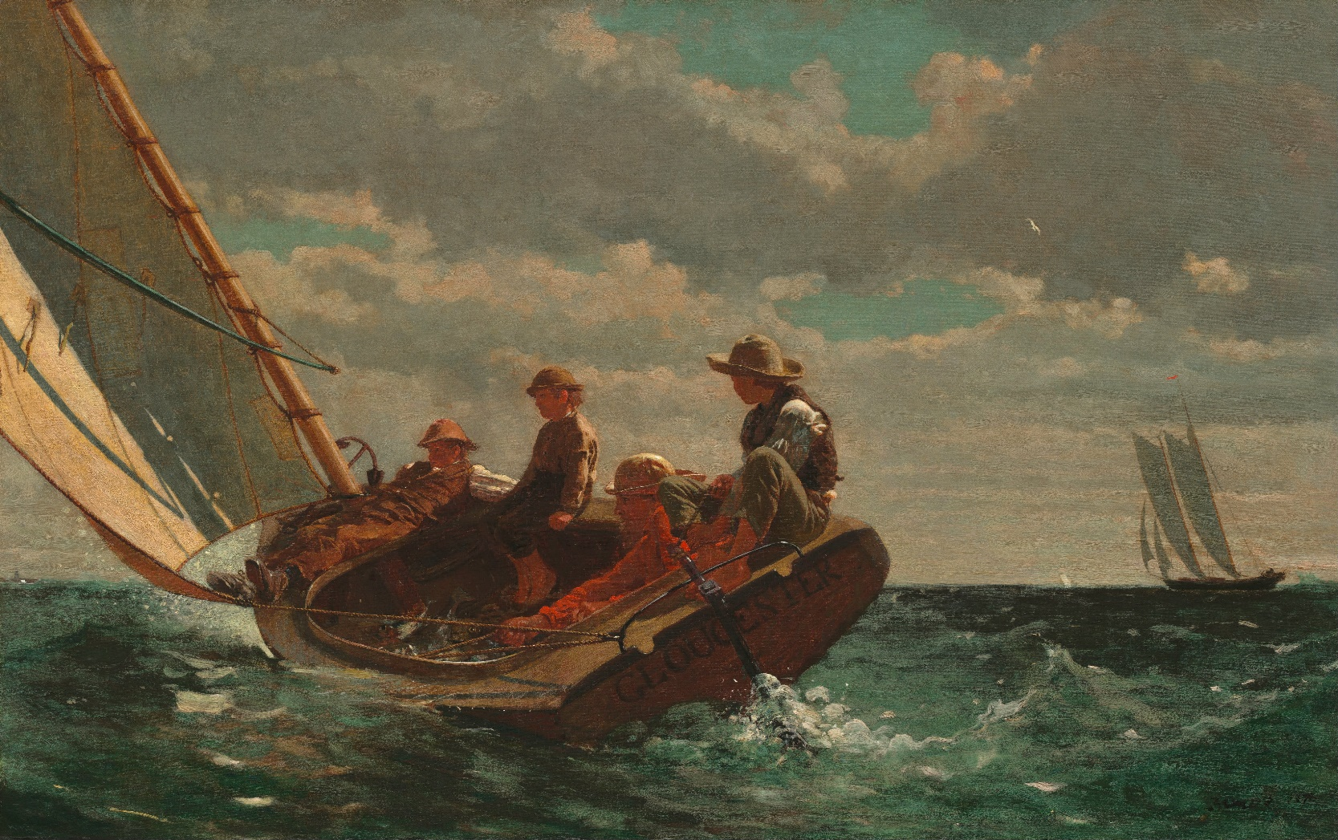
Breezing Up, Winslow Homer

Slide 5
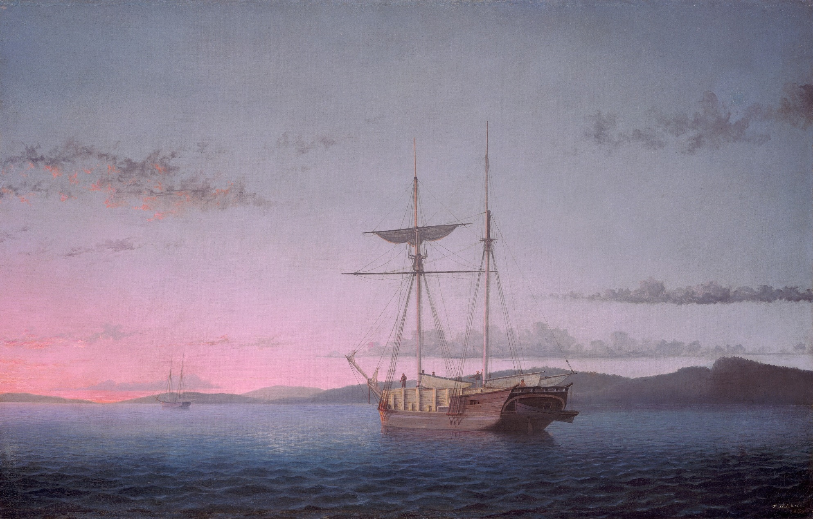
Lumber Schooners at Penobscot Bay, Fitz Lane

Slide 6
Activity
Choose a favorite activity that you enjoy watching or doing. It should involve movement. A few examples would be playing a sport, biking, or talking with friends.

Slide 7
Activity
Choose a favorite activity that you enjoy watching or doing. It should involve movement. A few examples would be playing a sport, biking, or talking with friends.
List adjectives that describe the activity, and the feelings you have while doing or viewing this activity.

Slide 8
Activity
Choose a favorite activity that you enjoy watching or doing. It should involve movement. A few examples would be playing a sport, biking, or talking with friends.
List adjectives that describe the activity, and the feelings you have while doing or viewing this activity.
Decide what types of lines would reflect this activity best. For example, watching a ballet may be soft, thin, wavy lines in pastel colors while jumping rope may be thick, zig-zag lines in bold hues.

Slide 9
Activity
Choose a favorite activity that you enjoy watching or doing. It should involve movement. A few examples would be playing a sport, biking, or talking with friends.
List adjectives that describe the activity, and the feelings you have while doing or viewing this activity.
Decide what types of lines would reflect this activity best. For example, watching a ballet may be soft, thin, wavy lines in pastel colors while jumping rope may be thick, zig-zag lines in bold hues.
Draw the activity you chose using a gesture drawing.

Slide 10
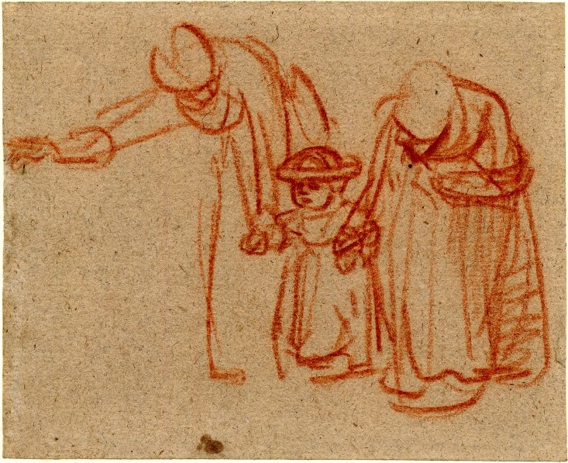
Gesture drawing
Two Women Teaching a Child to Walk, Rembrandt
Gesture drawing is used to show movement and action. Do not get hung up on the details of your drawing. Rather, use lines that simply represent that action of you activity.

