Slide 1
Nova Scotia

Slide 2
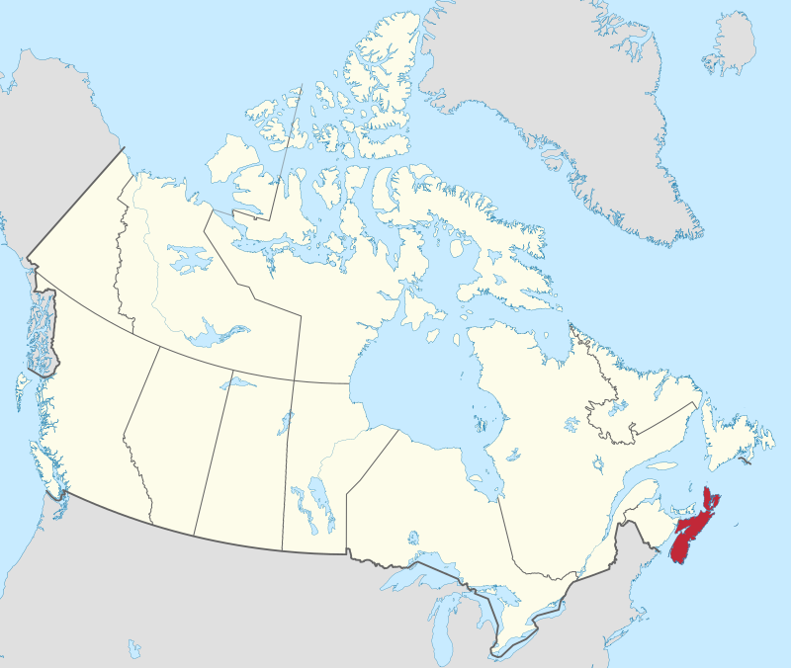
Nova Scotia
By MapGrid - Own work based on GIS data from:Natural Resources Canada. CanVec Series — Hydrographic Features.Natural Resources Canada. CanVec Series — Administrative Features.Statistics Canada. 2016 Census — Boundary files., CC BY-SA 4.0, https://commons.wikimedia.org/w/index.php?curid=98179172

Slide 3
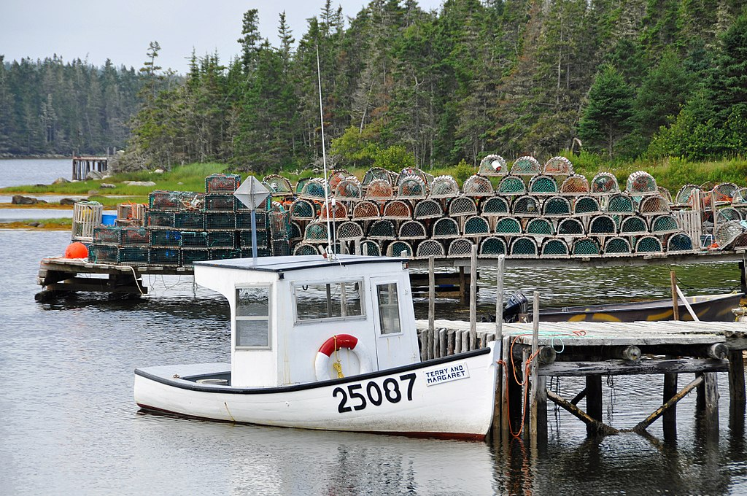
By Dennis Jarvis from Halifax, Canada - DGJ_7889 - I can&#039;t carry all those lobster traps!!!!!!!, CC BY-SA 2.0, https://commons.wikimedia.org/w/index.php?curid=66919193

Slide 4
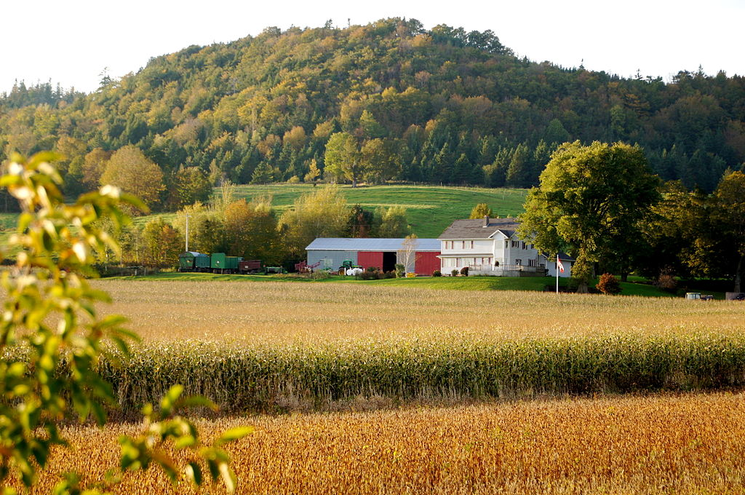
By Sharingknowledge - Own work, CC BY-SA 3.0, https://commons.wikimedia.org/w/index.php?curid=18868918

Slide 5
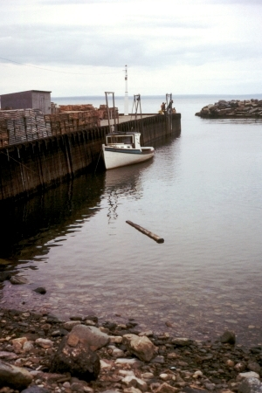
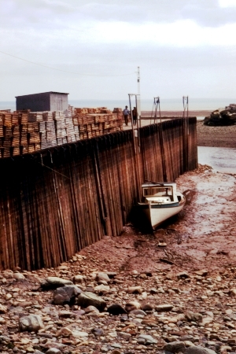
Bay of Fundy
High Tide
Low Tide
By © Samuel Wantman / Wikimedia Commons, CC BY-SA 3.0, https://commons.wikimedia.org/w/index.php?curid=225282
By © Samuel Wantman / Wikimedia Commons, CC BY-SA 3.0, https://commons.wikimedia.org/w/index.php?curid=225283

Slide 6
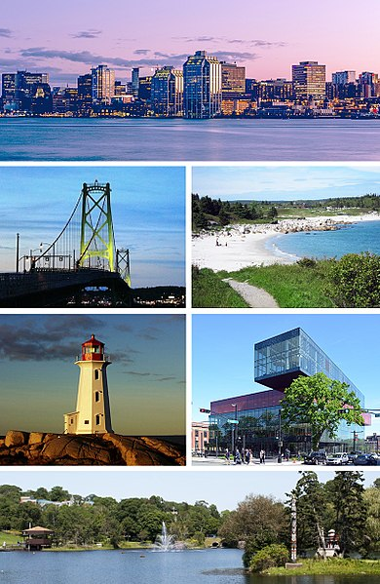
Halifax

