Slide 1
Yukon Territory

Slide 2
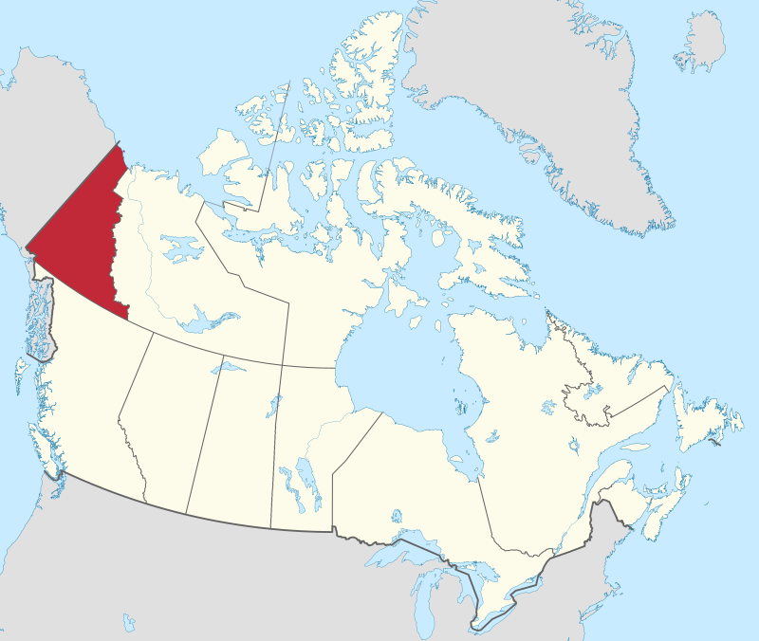
Yukon Territory
By MapGrid - Own work, CC BY-SA 4.0, https://commons.wikimedia.org/w/index.php?curid=98179268

Slide 3
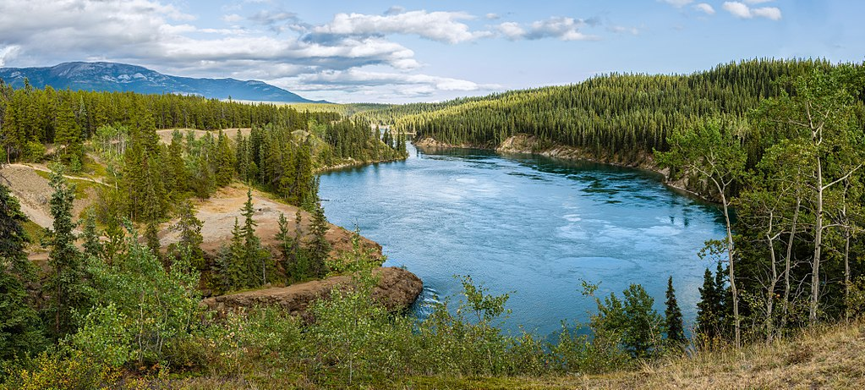
Yukon River
By Diego Delso, CC BY-SA 4.0, https://commons.wikimedia.org/w/index.php?curid=68630241

Slide 4
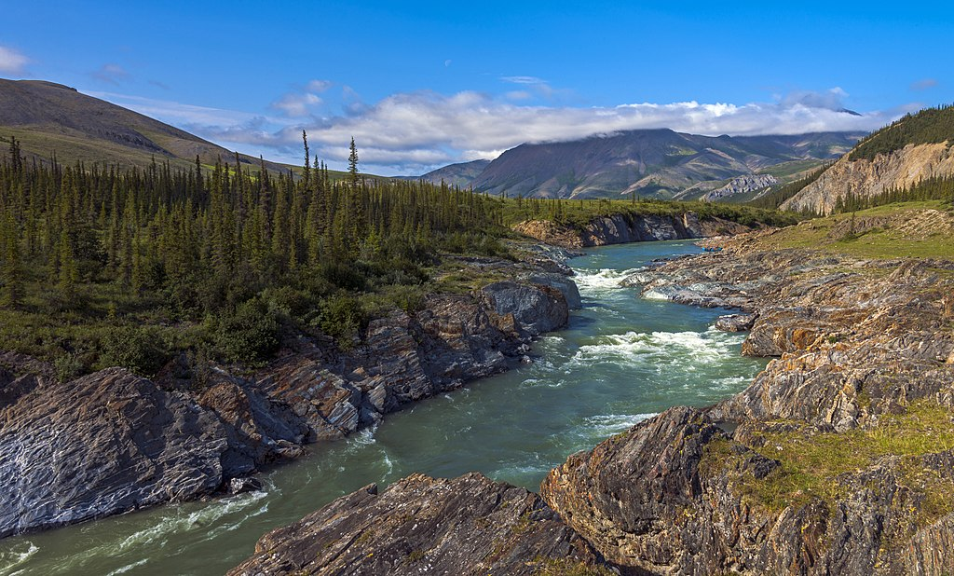
Ivvavik National Park
By Daniel Case - Own work, CC BY-SA 3.0, https://commons.wikimedia.org/w/index.php?curid=63321074

Slide 5
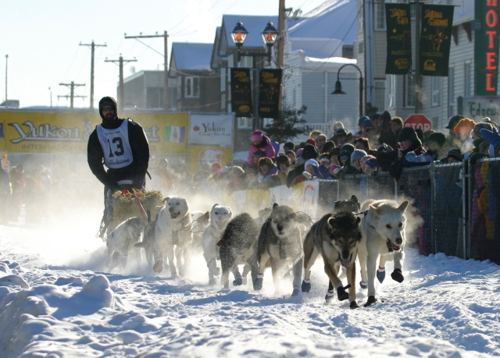
Dog Sledding race
By The original uploader was Magnol at German Wikipedia. - Transferred from de.wikipedia to Commons., CC BY-SA 3.0 de, https://commons.wikimedia.org/w/index.php?curid=2649212

Slide 6
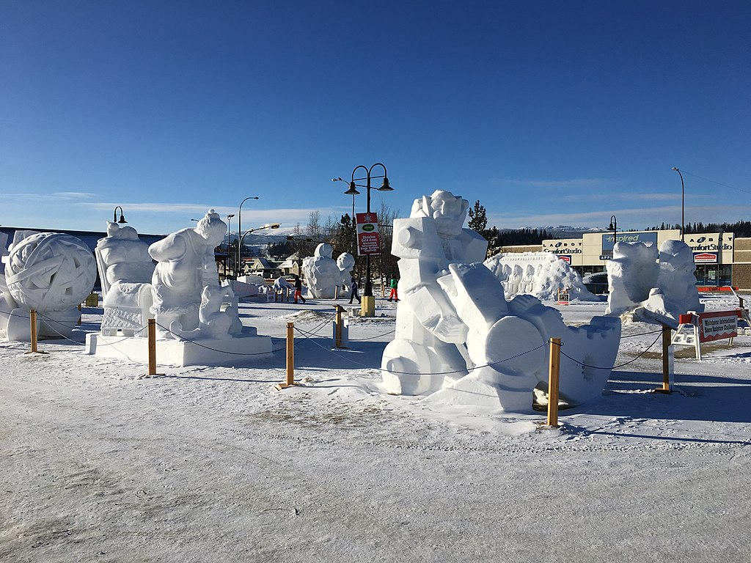
Snow Sculptures
By Rural Health Professions Action Plan from Canada - 2017 RPAP visit to Whitehorse, YT, CC BY 2.0, https://commons.wikimedia.org/w/index.php?curid=66235567

Slide 7
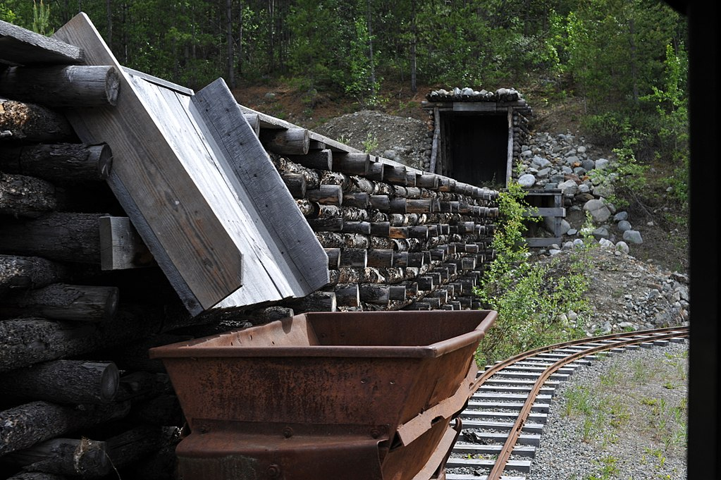
Mining
By Chris Hunkeler from Carlsbad, California, USA - Hopper and Cart, CC BY-SA 2.0, https://commons.wikimedia.org/w/index.php?curid=64192105

Slide 8
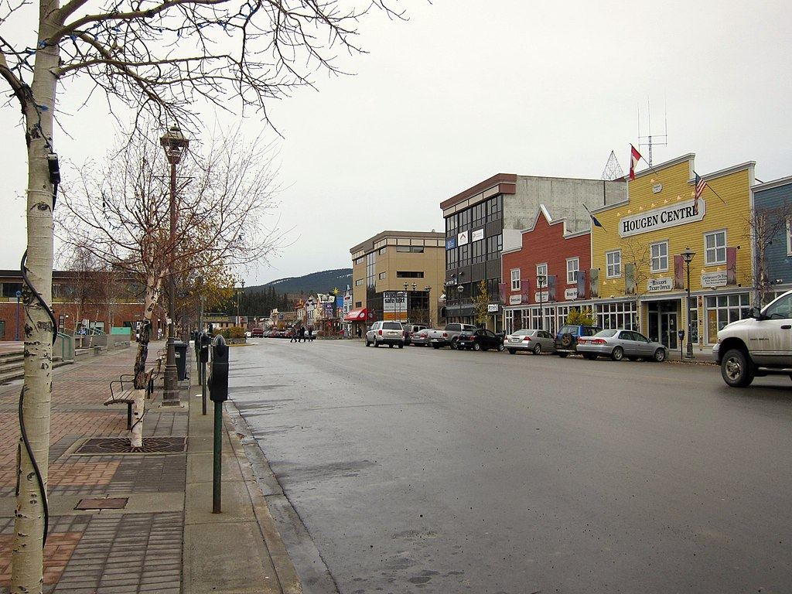
Whitehorse
Capital and Largest City
Population: 25,085
By Mike from Vancouver, Canada - Downtown Whitehorse, CC BY-SA 2.0, https://commons.wikimedia.org/w/index.php?curid=82076238

