Slide 1

Copy and paste these symbols onto the slides as needed.
✵
✵

Slide 2
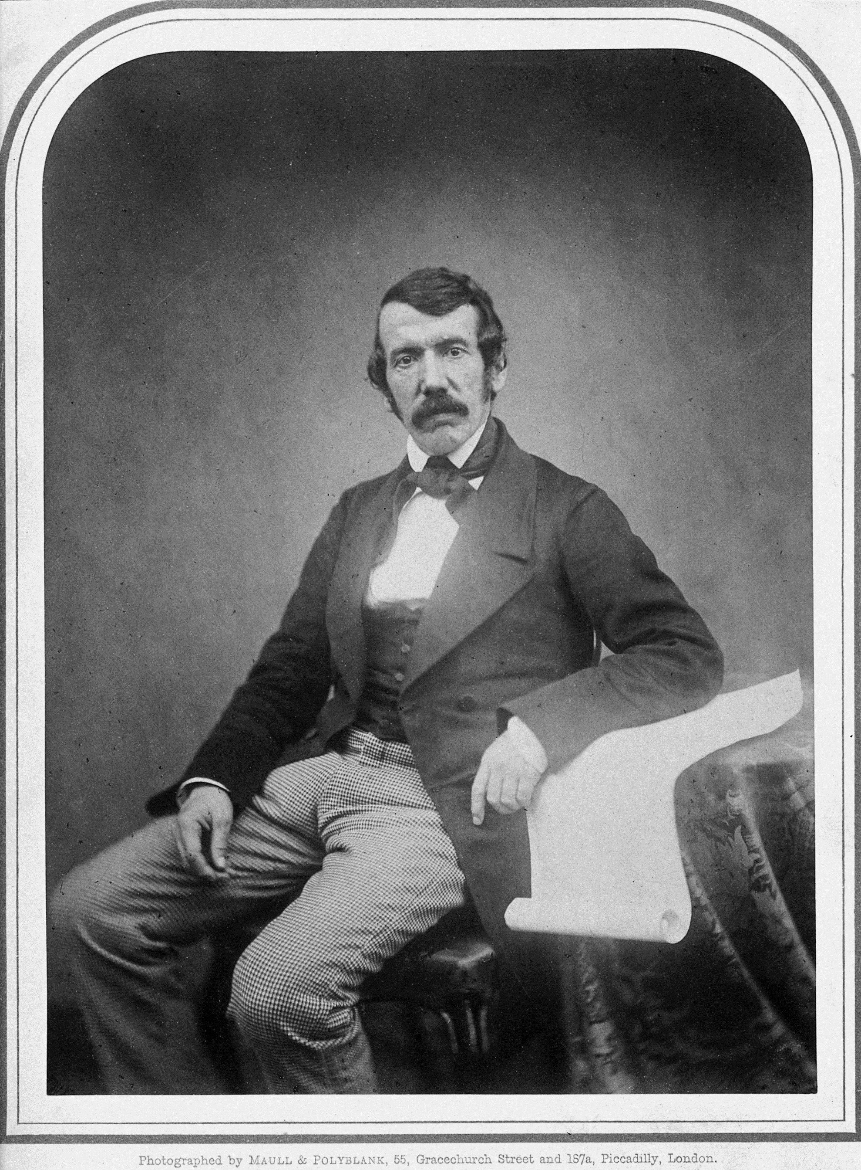

A Scottish pioneer missionary and scientific investigator, Livingstone explored Africa in search of a trade route that would help to end slave trade.
Southern Africa
✵
✵
David Livingstone
1813-1873

Slide 3
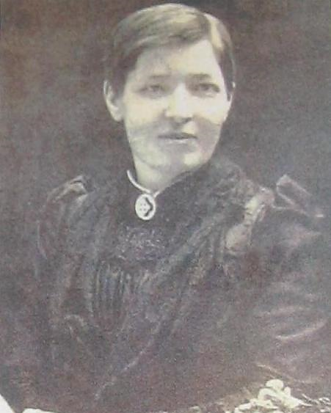
A Scottish missionary to Nigeria, Slessor gained the trust of the locals, spread Christianity, and stopped the practice of infanticide of twins.
Nigeria
✵
✵
Mary Slessor
1848-1915

Slide 4
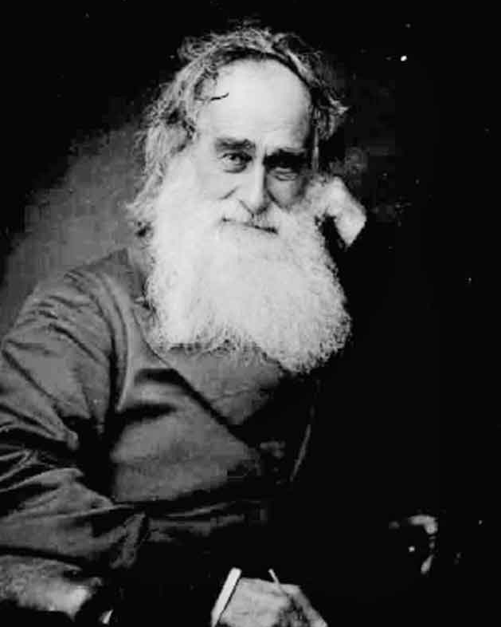
A Scottish missionary to Africa who worked passionately and endured hardship, Moffat was the first translator of the Bible into the Setswana language.
South Africa
✵
✵
Robert Moffat
1795-1883

Slide 5
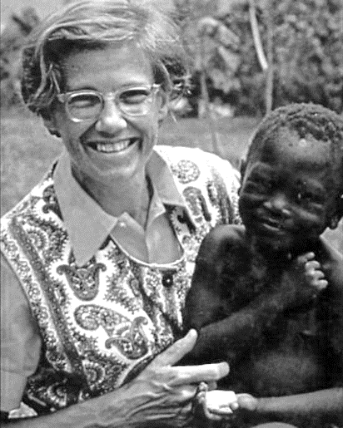
An English missionary and doctor, Roseveare worked in the Congo to rebuild a nation where she had been mistreated.
Congo
✵
✵
Helen Roseveare
1925-2016

Slide 6
An American missionary in Morocco for fifty years, Cary persevered in translation and evangelism among the Muslims.
Morocco
✵
✵
Maude Cary
1878-1967

