Slide 1
Industrial Revolution
World History 18a

Slide 2
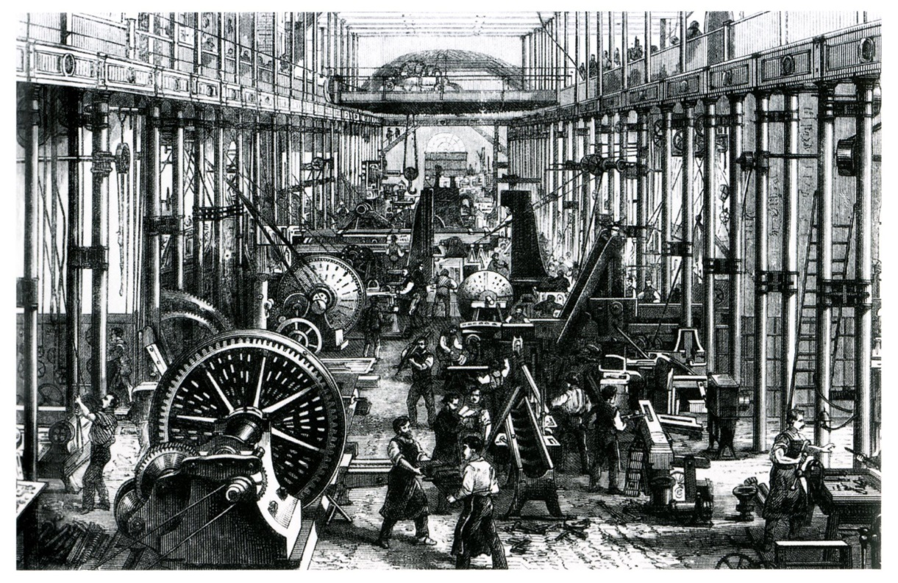
Factors that made possible the Industrial Revolution:
Adequate food supply
Large and mobile labor force
Expansion of trade

Slide 3
Agricultural developments
Seed drill
Crop rotation
Selective breeding
Larger farms

Slide 4
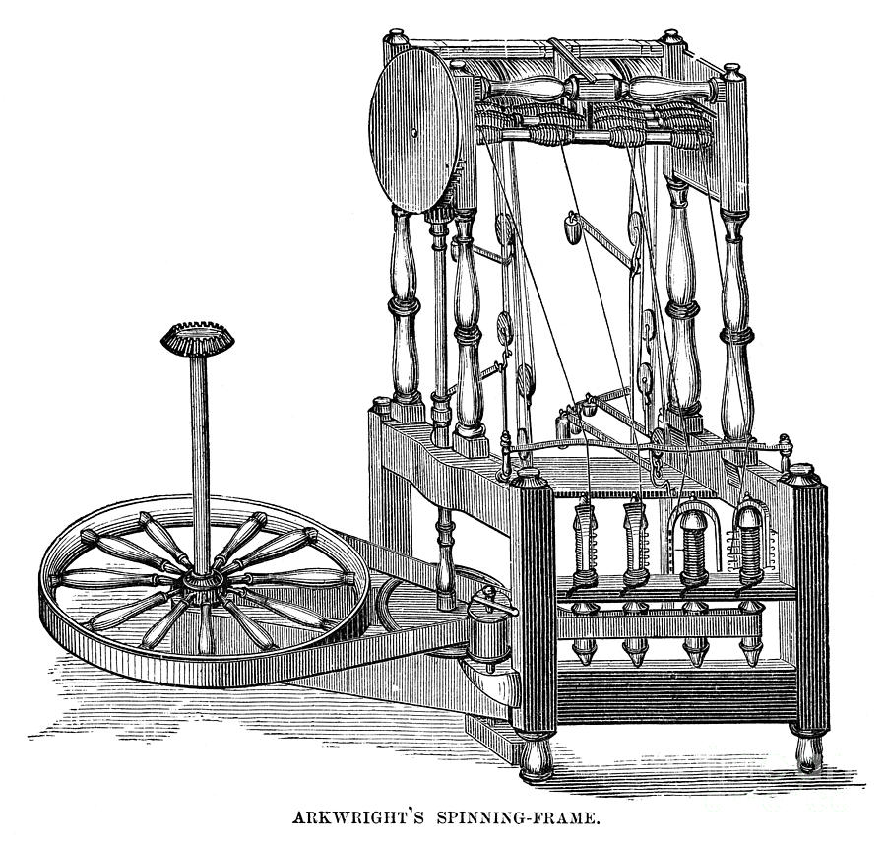
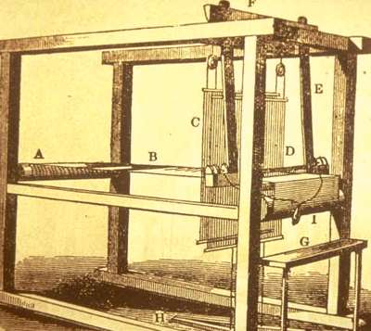
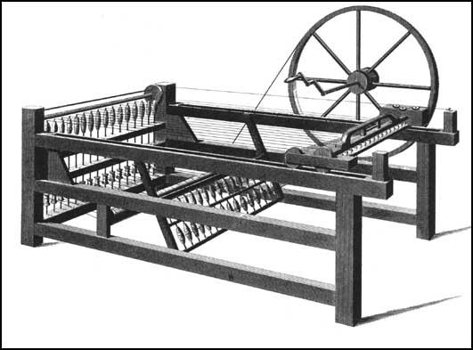
Textile Industry
Flying shuttle
Thread production
Spinning jenny
Spinning frame
Spinning mule

Slide 5
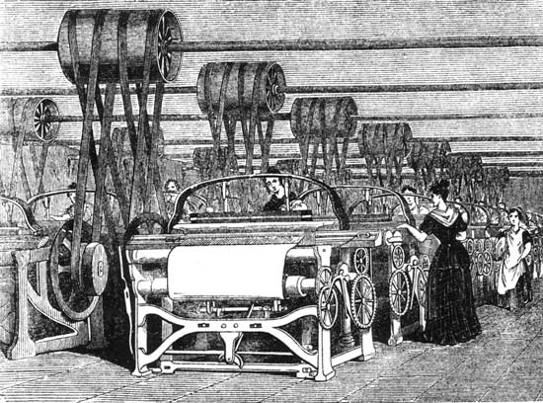
Factory system
These new machines triggered a shift from the domestic system (working at home) to the factory system (working in factory)

