Slide 1
The Great War
WH 20a

Slide 2
Factors Contributing to the Conflict
Extreme nationalism
Militarism
Imperialism
Rival alliances

Slide 3
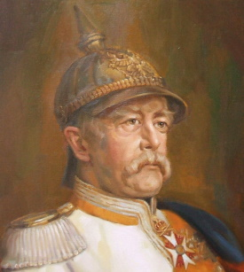
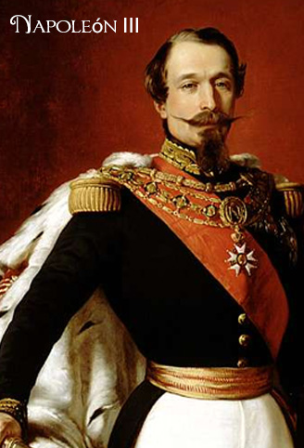
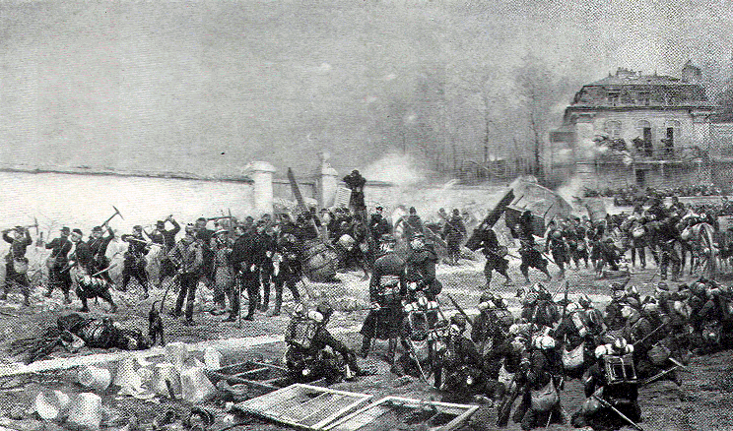
Franco-Prussian War

Slide 4
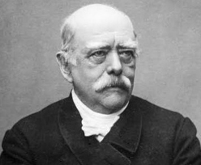
Germany and the triple alliance
After the Franco-Prussian War, Otto von Bismark began looking for ways to protect Germany from any future French attacks
First, he was able to establish a pact with Austria-Hungary to form the Dual Alliance (Russia was the primary fear in this deal)
Next, he was able to play on the French threat, to convince Italy to join the group, making it the Triple Alliance

Slide 5
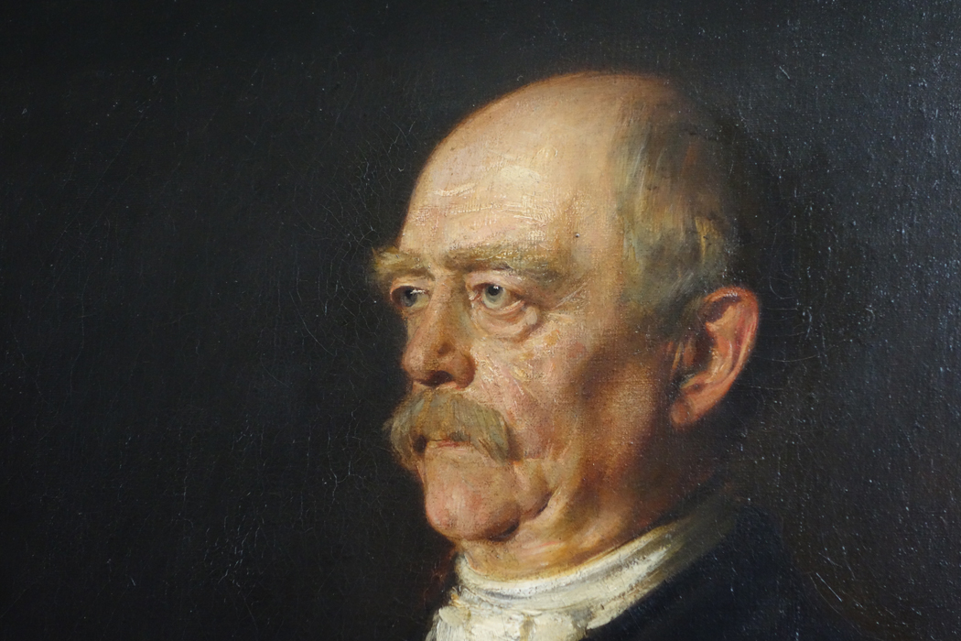
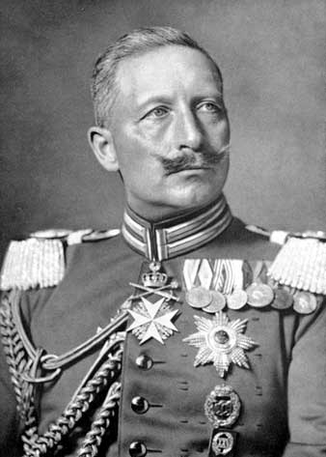
From otto to wilhelm II

Slide 6
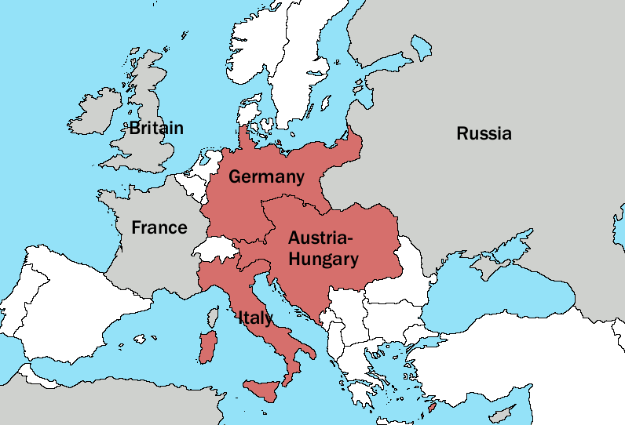
The Triple Entente
Out of fear that Germany would become too dominant in the region, England and France made an agreement to work together
Russia, also threatened by Germany, joined hands with England and France—this trio was called the Triple Entente

Slide 7
Balkans--Hotspot
Notes:
Add map of this area.

