Slide 1
End of WWII
WH 22e

Slide 2
The End in North Africa
In 1942-1943, British and American troops defeated the Axis forces in northern Africa
Notes:
Add map showing the campaign in North Africa in 1942-43.

Slide 3
The End in Europe
Notes:
Add map showing Europe in 1942, highlighting those countries dominated by Germany.

Slide 4
The End in Europe
By 1944, the Nazis were clearly on the defensive, just trying to hold their own
Invasion of Europe: Operation Overlord (D-Day)—June 6, 1944
Notes:
Add map showing the Invasion of Europe on D-Day.

Slide 5
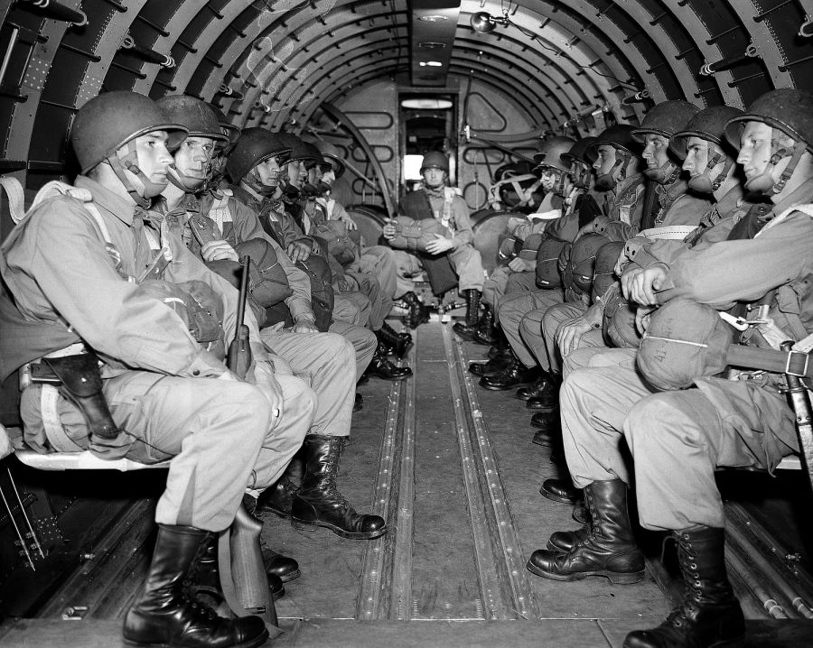
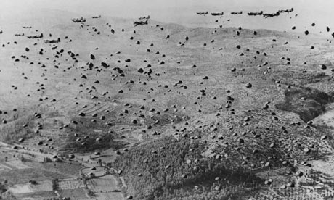
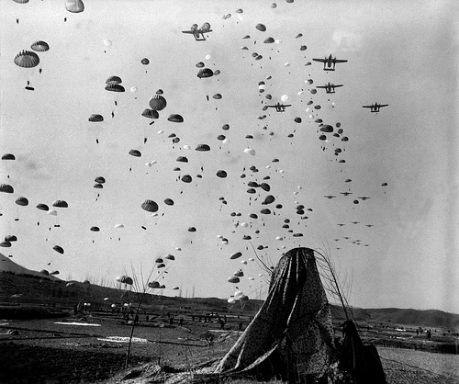
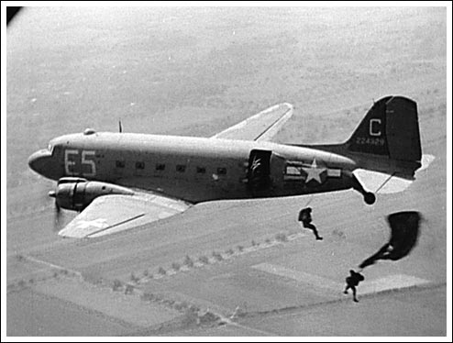

Slide 6
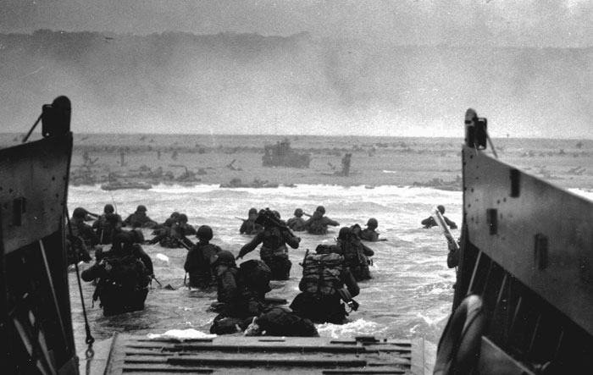
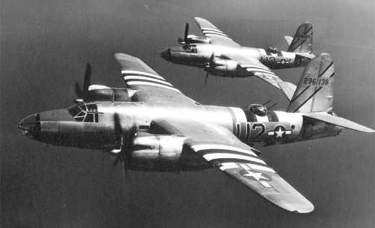
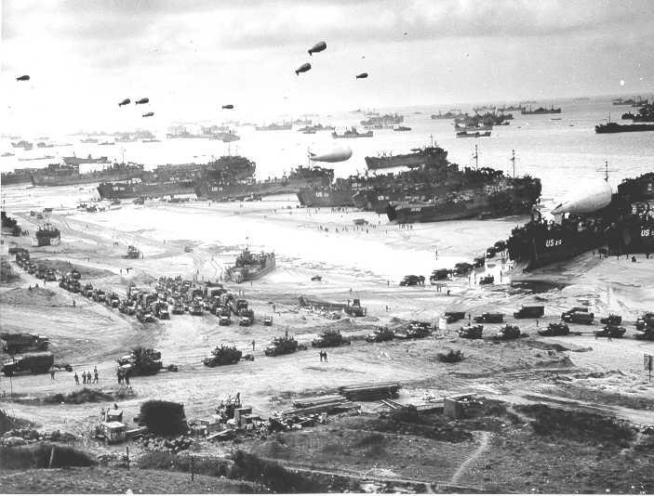
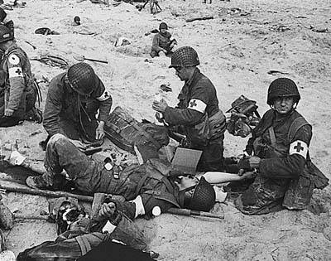
D-Day
June 6,1944

Slide 7
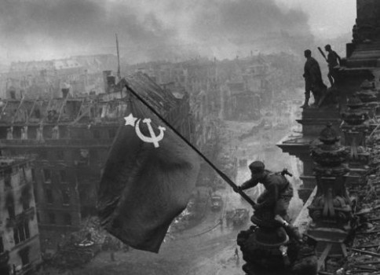
The End in Europe
Though costly, D-Day was successful; it was the beginning of the end for Hitler
As the western Allies pushed toward Berlin from the west, the Soviets pushed toward Berlin from the East
The Battle of the Bulge: one last desperate and unsuccessful counter0ffensive by the Nazis against the western Allies
Russian troops occupied Berlin in early May 1945
As troops were arriving in the city, Hitler shot himself, and his body was burned
May 7, 1945—the Germans surrendered

Slide 8
The End in the Pacific
Notes:
Add map of the battles in the Pacific.

Slide 9
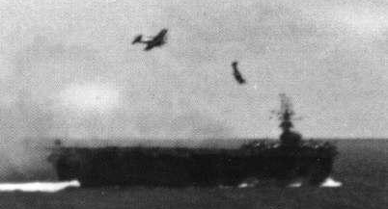
The End in the Pacific
The war in the Pacific was long and hard
Island-hopping, the US pushed closer and closer to Japan
Challenges: fanatical determination on the part of the Japanese, kamikaze pilots, banzai charges

Slide 10
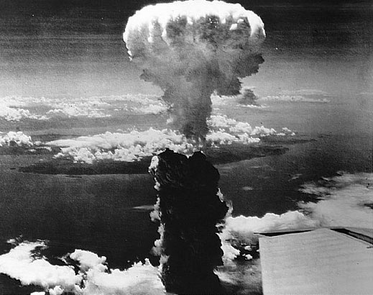
The End in the Pacific
Once within reach of Japan, the US dropped a terrific amount of bombs on Japanese cities, but still Japan refused to surrender
Atomic bombs:
Hiroshima
Nagasaki

Slide 11
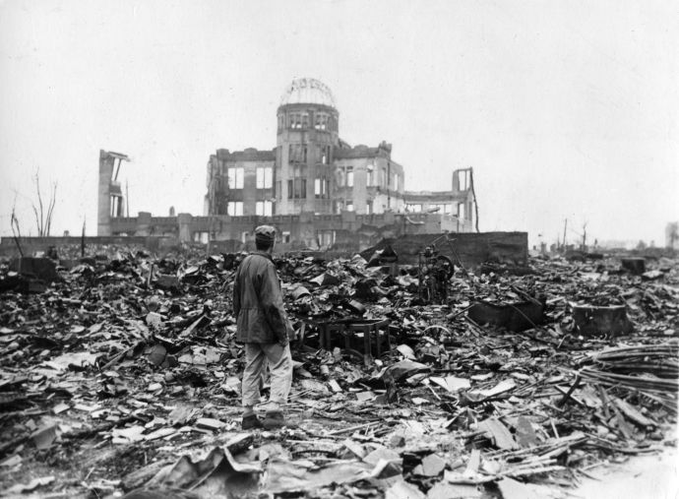
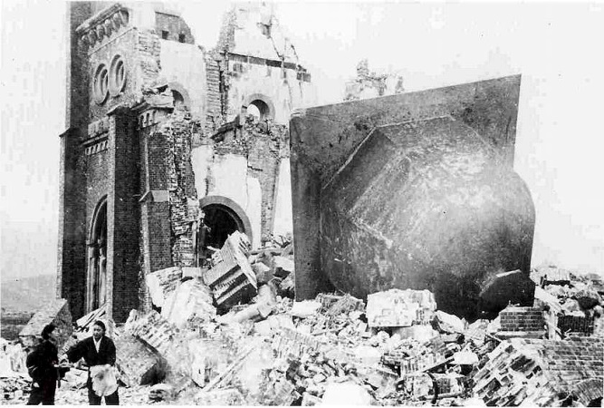
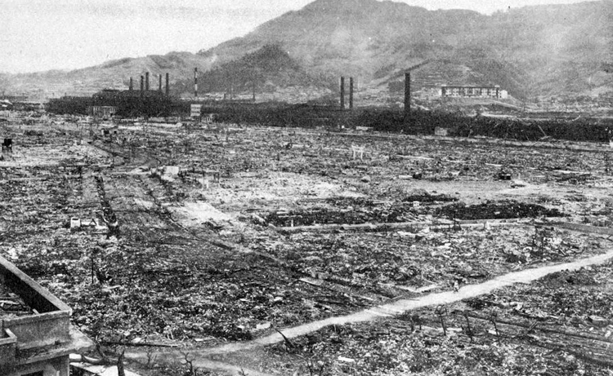
The ruins of the Urakami Christian cathedral in Nagasaki, Japan, photograph on Jan. 7, 1946

Slide 12
Horrible effects of nuclear bombs
Notes:
Add pictures of people burned by the nuclear bombs.

Slide 13
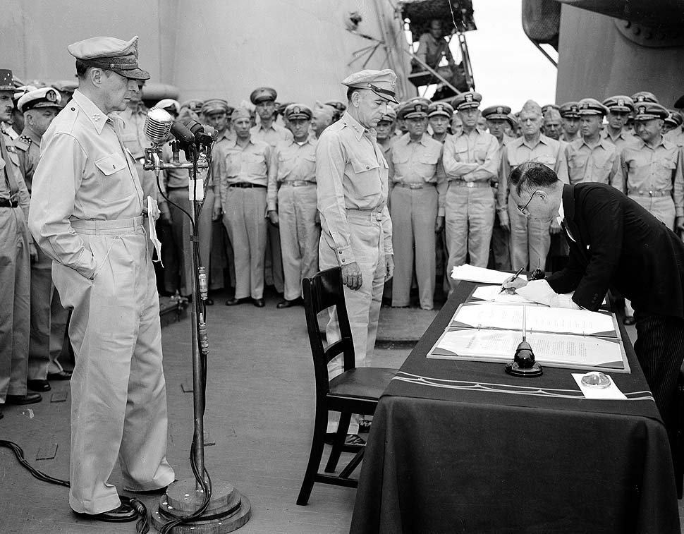
The End in the Pacific
Japan surrendered on Sept. 2, 1945

