Slide 1
Pope vs. King
World History 9a

Slide 2
Overview
In medieval Europe, a great contest between the church and state or the pope and the kings for the upper hand lasted for hundreds of years.
They each saw each other as legitimate, but disagreed over which one belonged at the top of the flagpole.
Over the years, the church steadily gained power until it emerged on top

Slide 3
The Issues
Control of land
Taxes and other financial favors
Appointment of church officials

Slide 4
Use this map to talk about the way that churches became such a heated battleground between kings and the pope. Suppose a noble in the kingdom of Savoy granted a fief to the church and the church used the fief to make wine and therefore profits. Who is going to benefit from those profits—the king or the pope? Who is going to get the tax money from that property? If the priest/bishop is loyal to the king, funds will flow his way; if he is loyal to the pope , funds will flow his way. Whoever has the power to appoint these men to these positions will be the one who benefits.
Notes:
Add a map of Europe in the middle ages, showing its many countries and the way power was divided.

Slide 5
Henry IV and Gregory VII
Notes:
Add picture.

Slide 6
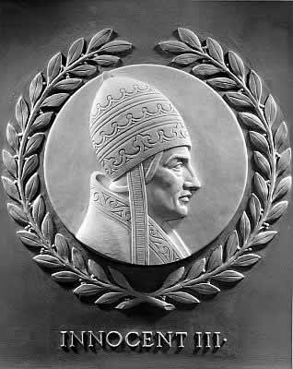
Pope Innocent III (1200)
The papacy reached its greatest power under Pope Innocent III.

Slide 7
The Pope’s Weapons
Excommunication: depriving a person of the sacraments and fellowship of the church and, in Catholic theology, of eternal salvation
Interdict: suspending all public church services in a region, putting pressure on a group of people to submit to the pope or run the risk of offending God
Inquisition: a church court designed to find and eliminate heretics

