Slide 1
The Clash of Worldviews
UTT-0.2
Notes:
Mr. Meyers had different picture slides included in the presentation that we needed to cut because of copyright laws. Included were pictures of Stalin and death camps, angry protestors with signs, a gay marriage, handicapped children in an obviously neglected setting and a few others.

Slide 2
Does our worldview really matter?
Isn’t the study of philosophy and worldviews basically a mind game? What difference does it make how you answer these questions?
Where did life come from?
What is the purpose of life?
Is there a God?
Who am I?
What determines what is right and wrong?
Is there life after death?
What is wrong with the world and what is the solution?

Slide 3
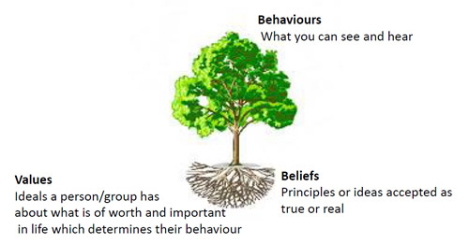

Slide 4
Choose ye this day…

